Slide 1
How do YOU ARPA?
Lori Thomas, Mike Sell, Ed Driggers & Ray Jones

Slide 2
How We Got Here
The Coronavirus State and Local Fiscal Recovery Funds (“SLFRF”) are a part of the American Rescue Plan Act (“ARPA”) designed to support local governments’ response to and recovery from COVID-19.
Treasury published the interim final rule on the usage of SLFRF funds in May 2021.
The final rule was published January 2022 and was effective April 2022.

Slide 3
Framing the Conversation
Funds must be used for costs incurred on or after March 3, 2021.
Funds must be obligated by December 31, 2024.
Funds must be expended by December 31, 2026.

Slide 4
Eligible Uses
4 categories of eligible uses:
Lost Revenue
Standard allowance of up to $10 million which may be used for governmental services (defined as any service traditionally provided by a government e.g., construction of schools and hospitals, road and infrastructure projects, provision of public services, environmental remediation, health services, government administration costs, etc.)
COVID-19 Public Health and Economic Response
Programs and services related to COVID-19 as well as capital expenditures that support public health and negative economic impacts
In general, (1) identify a COVID-19 impact on a specific household, small business, nonprofit, industry or class and (2) design a program tied to that negative impact
Capital expenditures are eligible but may come with reporting obligations
Premium Pay
Pay for eligible workers (generally those working in-person who earn 150% of County’s average wage or less and/or are non-exempt from Fair Labor Standards Act overtime)
Water, Sewer and Broadband Infrastructure
Broad range of eligible projects including those under the EPA’s Clean Water Revolving Fund, EPA’s Drinking Water State Revolving Fund, lead remediation, stormwater infrastructure and expanding broadband to underserved areas

Slide 5
We are the Government, and We are Here to Help
Opportunities and Caution with Federal Money
Unprecedented
Manage Council expectations
Typical Approach to Federal money
Be careful with one-time money for ongoing expenses
How to use these funds to address your needs
Look at your existing capital plan to see if any projects are eligible
Use in combination with other funds
Resources

Slide 6
Real World ARPA in South Carolina
County Perspective

Slide 7
Real World ARPA in South Carolina
City Perspective

Slide 8
Restrictions, Deadlines and Audit Risk
Bright-line Restrictions on SLFRF funds
Deposits to pension funds to reduce unfunded liability
Payment of debt service
Replenishing rainy-day funds
Satisfaction of settlements or judgments
Construction of correctional facilities, convention centers, stadiums or capital projects designed for general economic development
Timeline
Funds must be “obligated” by December 31, 2024
Treasury has said obligated means an order has been placed for property and services, a contract has been entered into, subawards have been made, or similar transactions that require payment have been undertaken
Funds must be “expended” by December 31, 2026
Treasury has said this refers to “liquidating the obligations”
Audit Activity
You can earn interest!

Slide 9
Resources
SC Recipients
Overview of Final Rule
FAQs regarding Final Rule

Slide 10
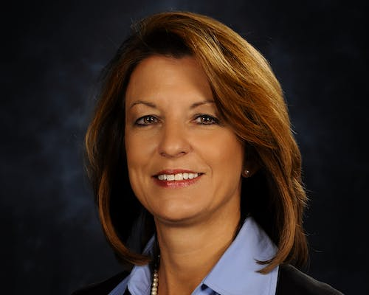
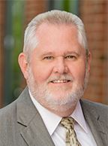
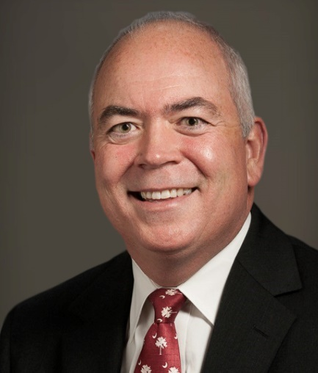
Questions?
Lori Thomas, thomas.lori@richlandcountysc.gov
Mike Sell,
msell@cityofgreer.org
Ed Driggers,
ed@parkerpoeconsulting.com
Ray Jones,
rayjones@parkerpoe.com

