Slide 1
Resilience Through Collaboration: Together We Thrive
South Carolina Office of Resilience, Ben Duncan
Maximizing State Agency Partnerships, SCCCMA June 16, 2023

Slide 2
SCOR lessens the impact of disasters on the communities and citizens of South Carolina by planning and coordinating statewide resilience, long term recovery and hazard mitigation.
Our Mission

Slide 3
The ability of communities, economies, and ecosystems to anticipate, absorb, recover, and thrive when presented with environmental change and natural hazards.
What is Resilience?

Slide 4
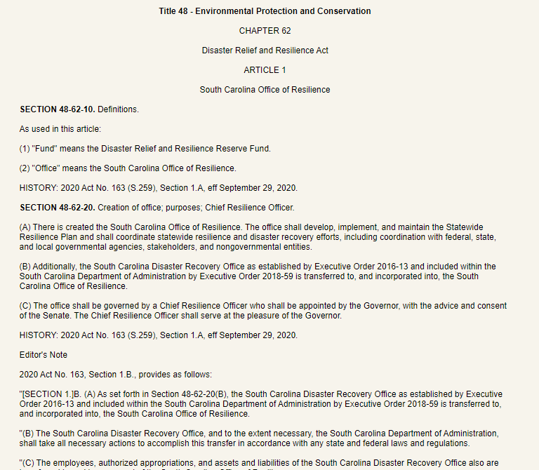
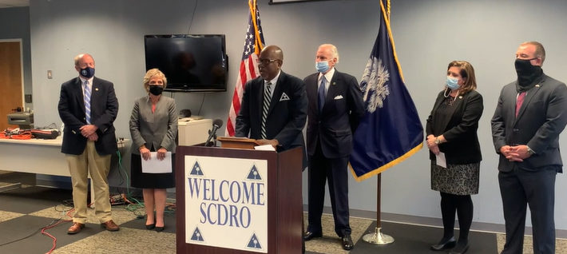
Disaster Relief and Resilience Act
Effective Sept 29, 2020, the Disaster Relief and Resilience Act (S.C. Code. Ann. § 48-62-10, et. seq.) created the SC Office of Resilience, absorbing SCDRO into its operations.
Tasked the office with developing, implementing, and maintaining the Strategic Statewide Resilience and Risk Reduction Plan (Resilience Plan)
Requires coordination of statewide resilience and disaster recovery efforts and collaboration with federal, state, and local stakeholders
Created two funds:
Disaster Relief and Resilience Reserve Fund (Reserve Fund)
Resilience Revolving Fund (Revolving Fund)
SCDRO Director Ben Duncan was appointed as the state’s first Chief Resilience Officer. The SC Senate confirmed the nomination on April 7, 2021.

Slide 5
What We Do
RESILIENCE
Development and management of the Strategic Statewide Resilience & Risk Reduction Plan
Management of the Disaster Relief and Resilience Reserve Fund and the SC Resilience Revolving Fund
MITIGATION
Buyouts: Voluntary acquisitions of repetitively flooded land and property in order to return it to green space
Infrastructure: Traditional “Gray” and Nature-based “Green” Infrastructure
Plans & Studies: Funding for local governments and state agencies to develop and/or update hazard mitigation plans, stormwater plans, and more
Matching Grants: Provide the local cost share for other federal flood mitigation programs
DISASTER RECOVERY
Long-term recovery: rebuild and replace homes damaged by hurricanes and flooding in FEMA-declared counties; funded by HUD CDBG-DR
PREPAREDNESS
RESPONSE
RECOVERY
MITIGATION
DISASTER CYCLE

Slide 6
History
2015
2016
2018
2018
2020
2021
SC Disaster Recovery Office was created following Historic Floods of 2015, which resulted from Hurricane Joaquin
Hurricane Matthew
Hurricane Florence
Floodwater Commission established
Disaster Relief and Resilience Act was signed, creating the Office of Resilience
Officially began operation at the start of FY 2022

Slide 7
Current HUD Grants
 | 2015 Severe Storm (CDBG-DR) | 2016 Hurricane Matthew (CDBG-DR) | 2018 Hurricane Florence (CDBG-DR) | 2020 Mitigation (CDBG-MIT)
Grant Authority | HUD | HUD | HUD | HUD
Grant Amount | $126 Million | $95 Million | $72 Million | $162 Million
Service Area | 22x IA Declared Counties (8x MIDs) | 24x IA Declared Counties (4x MIDs) | 8x IA Declared Counties (3x MIDs) | 9x HUD MID Counties 8x SC MID Counties
End of Construction/ Program | September 2021 | 2022 | NLT 2026 | NLT 2032
MID = Most Impacted and Distressed

Slide 8
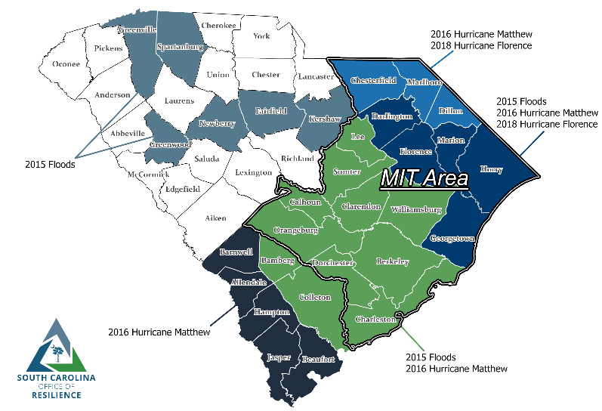
CDBG-DR & CDBG-MIT Area of Operations

Slide 9
Resilience Planning

Slide 10
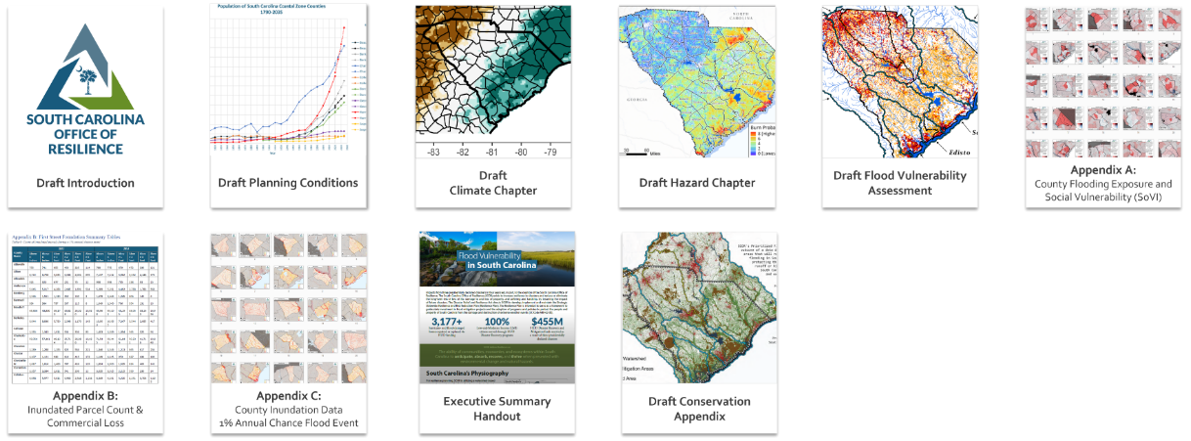
Resilience Planning
The South Carolina Office of Resilience is responsible for developing and implementing a Strategic Statewide Resilience and Risk Reduction Plan (Resilience Plan). The Plan identifies major flood risks around the state and potential losses that could occur as a result of extreme weather events. The Plan will provide strategies for local governments to implement resilience into their communities in order to mitigate potential flood risks.
SCOR has released draft chapters of the plan which are available for review online.
All draft documents are available for review at scor.sc.gov

Slide 11
Other Initiatives

Slide 12
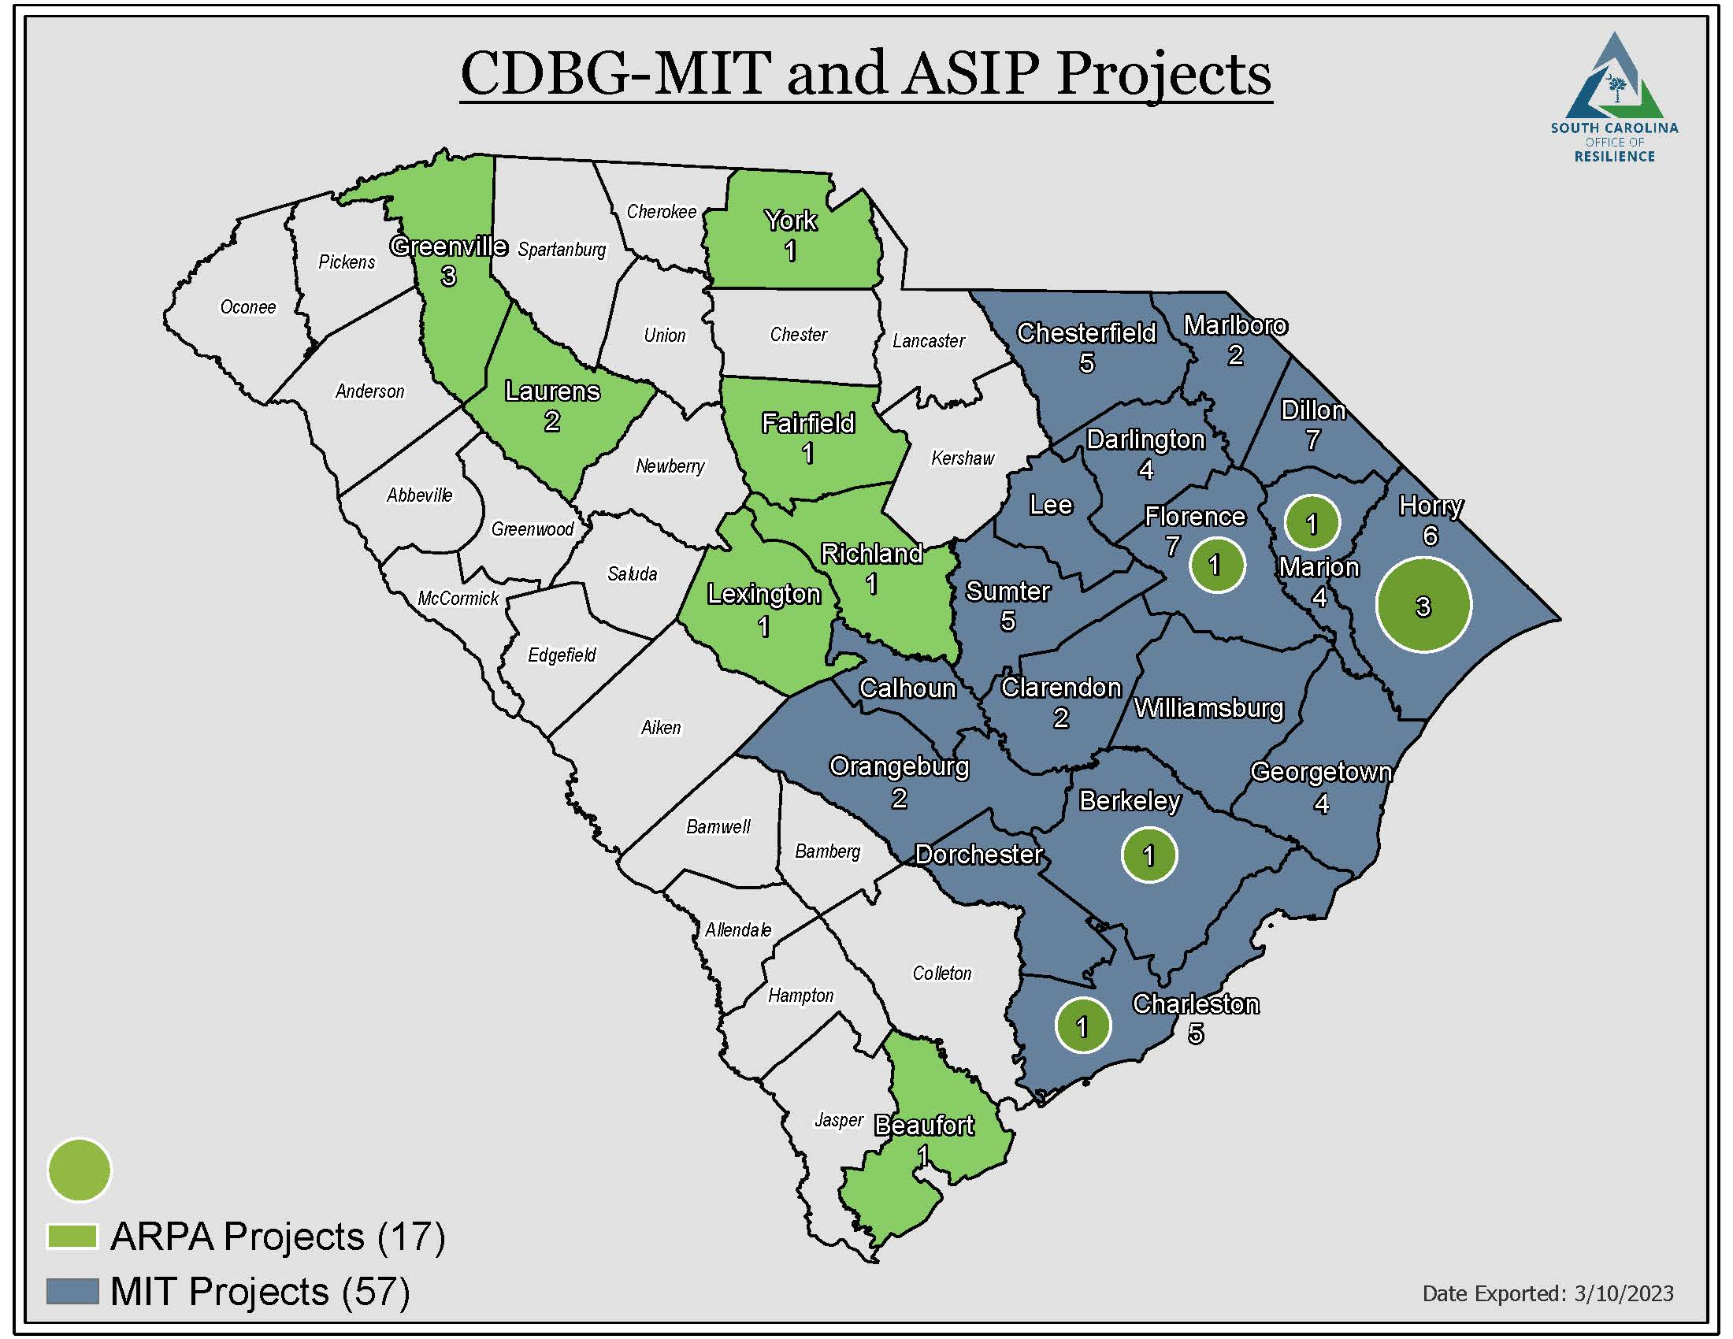
American Rescue Plan Act (ARPA)
Stormwater Infrastructure Program
$55 million for green (nature-based) and grey (traditional) infrastructure projects for local governments
All 46 counties in SC were eligible to apply – 17 projects awarded
Part or all of the selected projects feature green infrastructure

Slide 13
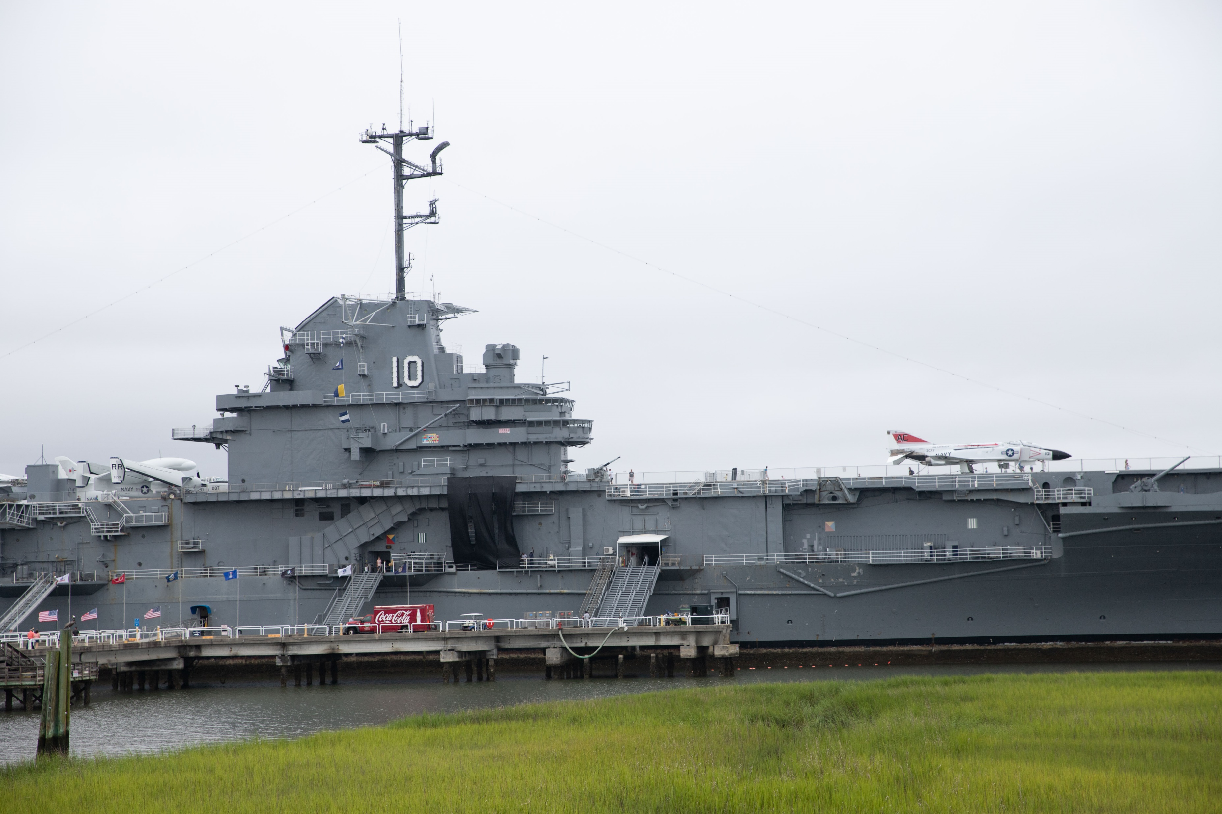
USS Yorktown Remediation
Governor McMaster authorized SCOR to study the cost of removing or remediating all legacy contaminants
Initial survey assessment estimates there are over 1,500 different compartments or spaces
At this time we are not aware of any immediate risks of release of existing contaminants, but previous surveys have estimated there are around 1.75 million gallons of contaminated water and 3,000 gallons of fuel on board, as well as PCA’s and PCB’s
Updated estimates of materials on board will likely be available before summer 2023
The full study and plan for remediation will be complete by the end of 2023
SC Office of Resilience | PAGE

