Slide 1
SCEMD – Mitigation Opportunities
Candice Shealey, SC CEM
State Hazard Mitigation Officer
South Carolina Emergency Management Division

Slide 2
Topics
SCEMD overview
What is mitigation?
Mitigation planning
Funding opportunities
Partnership-building project

Slide 3
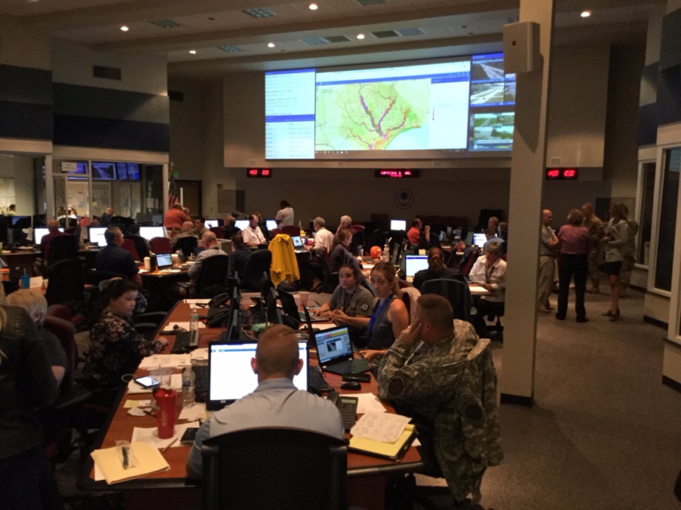
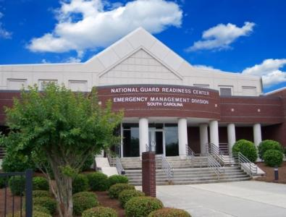
SCEMD
The South Carolina Emergency Management Division (SCEMD) leads the state emergency management program by supporting local authorities to minimize the loss of life and property from hazard events.
  Preparedness
  Operations
  Logistics/operations support
  Recovery and mitigation
  Finance and administration
  Public information
State Emergency Operations Center (SEOC)
Notes:
SCEMD is a division of the Military Department of South Carolina under the Adjutant General, but the Division reports directly to and advises the Governor during major emergencies and disasters.

Slide 4
Response and Recovery Support
Municipality Handles Incident
Requests assistance
County Handles Incident
Requests assistance
State Provides Resources
Requests assistance
Federal Provides Resources

Slide 5
State Support and Coordination
State Emergency Response Team (SERT) (state agencies)
Mutual aid (intrastate and interstate)
Coordination tools: State Emergency Operations Center (SEOC), communications systems, PalmettoSC platform
Mitigation planning and support for mitigation project development
Preparedness including risk assessment, all-hazards planning, training, exercise, equipping, and public awareness/information
Recovery planning and state Recovery Task Force

Slide 6
What is mitigation?
Any long-term, sustained action to reduce future risk to people and property from natural or human-caused hazards.

Slide 7
Why mitigate?
Save lives and property
Reduce post-disaster impacts -
  Overall recovery time
  Financial recovery
  Infrastructure re-building

Slide 8
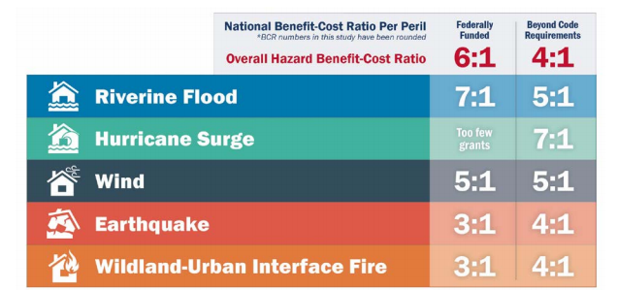
Save Future Disaster Costs

Slide 9
Mitigation Process
Mitigation Planning
Mitigation Projects
Risk Assessment

Slide 10
Identify Hazards and Risk
Hazard identification risk assessment (HIRA) uses:
  Recent and historical events
  Data and research
  Community input
  Longstanding, known issues
Considers physical and social vulnerability

Slide 11
Create/Update a Mitigation Plan
Update-to-date HIRA as foundation
Analyze and interpret community development and growth
Create mitigation goals
Develop mitigation actions to support those goals and address the hazards
Solicit input and participation from the community and stakeholders
Submit plan for review and approval by FEMA (through SCEMD)
Adopt it!!!

Slide 12
Conducting Mitigation Projects
Create mitigation projects based on mitigation actions
Look for available funding opportunities
Apply for funding and complete the projects when able
Ongoing cycle

Slide 13
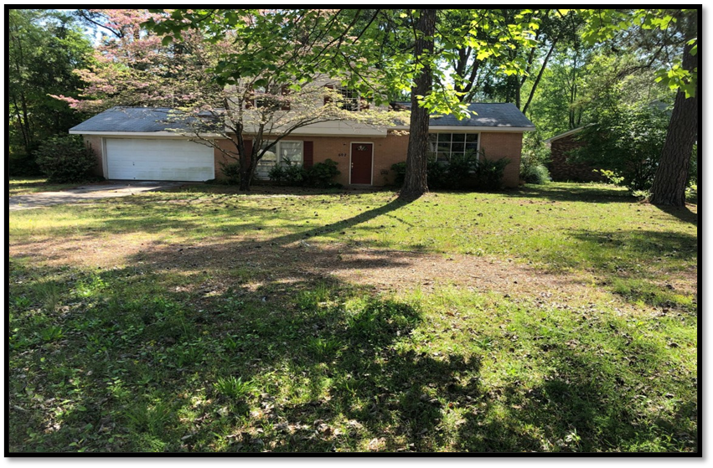
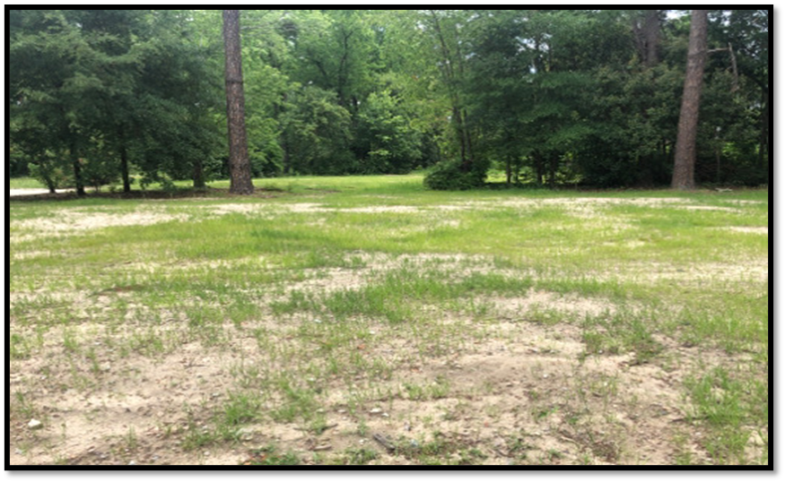
Mitigation Actions - Examples
Before
Acquisition/demolition
Community/household safe rooms
Flood control/infrastructure
Retrofits
Back-up power to critical racilities
Mitigation planning
Advance assistance/project scoping
After

Slide 14
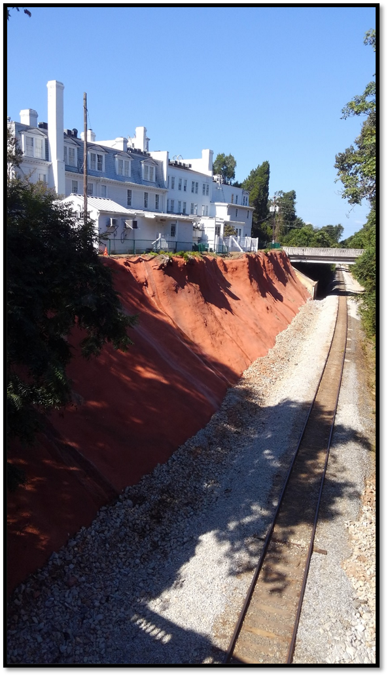
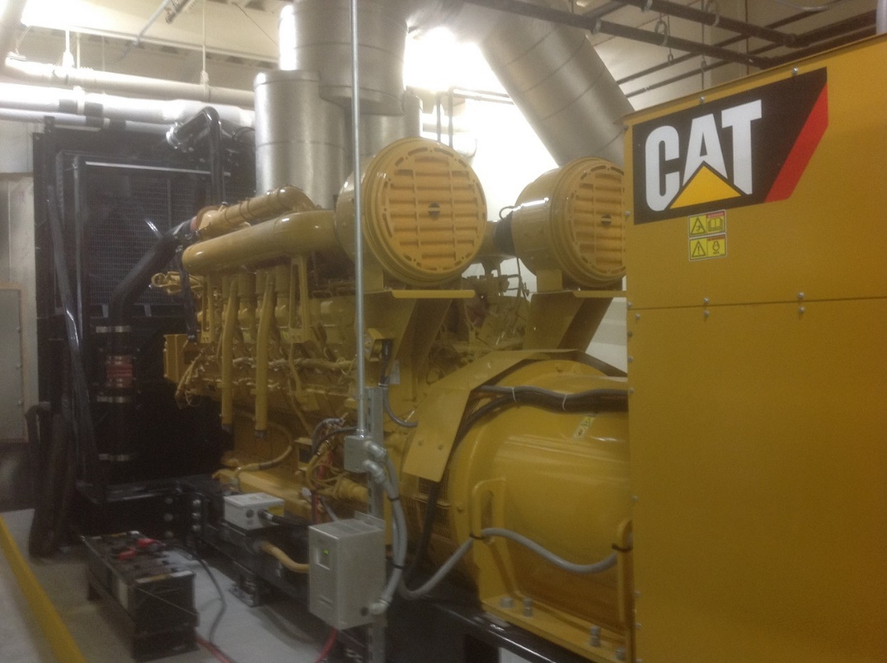
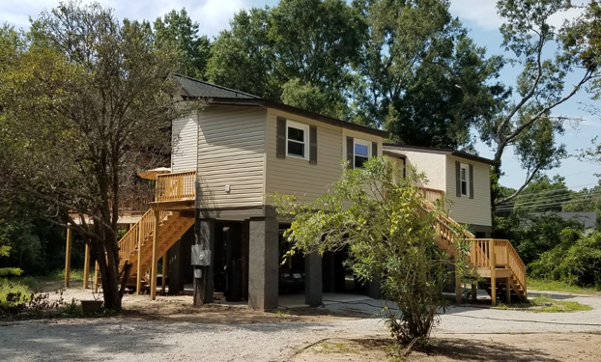
Examples

Slide 15
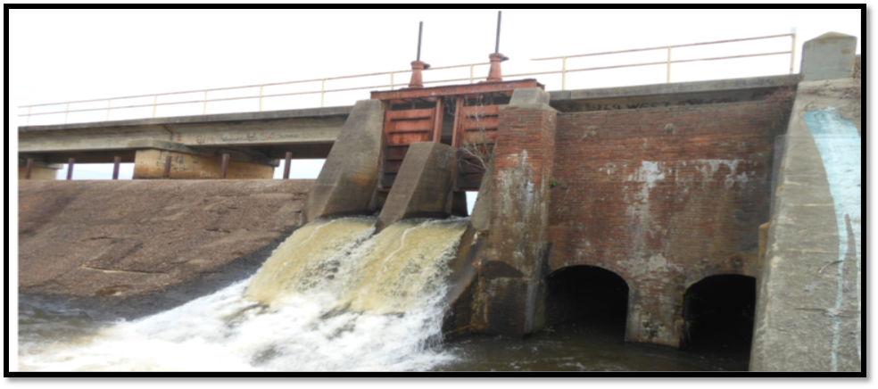
Examples
Before
After

Slide 16
SCEMD-Administered Grants
Building Resilient Infrastructure and Communities (BRIC)
Hazard Mitigation Grant Program (HMGP)
Congressional Local Pre-Disaster Mitigation (LPDM)

Slide 17
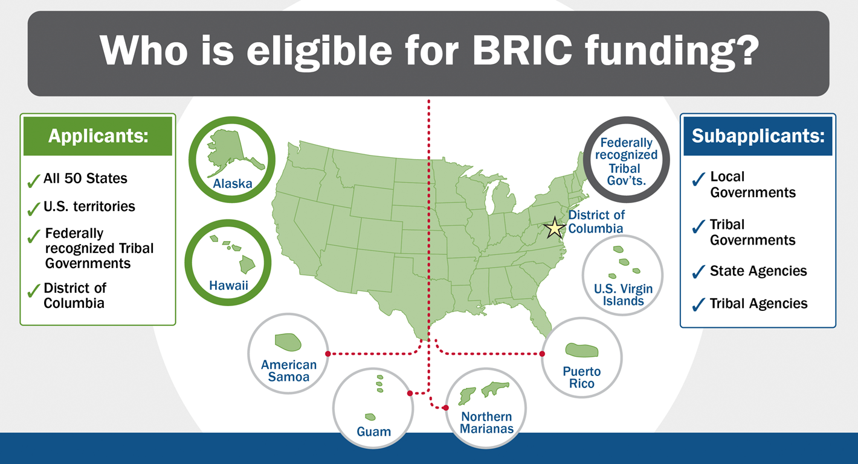
BRIC Overview
Annual federal appropriation
Two submission categories:
  National competition ($50M federal funding cap)
  State set-aside
Reimbursement-based grant at 75% federal 25% non-federal share
  Economically Disadvantaged Rural Communities can be 90% fed/10% non-fed
Application cycle September-January
Notes:
BRIC replaces the Pre-Disaster Mitigation (PDM) program.
Note that the changes in the program are as a result of the Disaster Recovery Reform Act of 2018.
State Set aside is for Plans/Planning Related Activities, Project Scoping, and Projects.

Slide 18
BRIC Category-State Set-Aside
State set-aside
  Mitigation Planning and Planning-Related Activities (not eligible under national competition)
    Amount capped within the state set-aside
  Capability and Capacity-Building Activities (not eligible under national competition)
    Project scoping – activities that help develop mitigation strategies and obtain data to prioritize, select, and develop complete applications
    Building code enhancement/adoption
    Partnership-building
  Mitigation projects

Slide 19
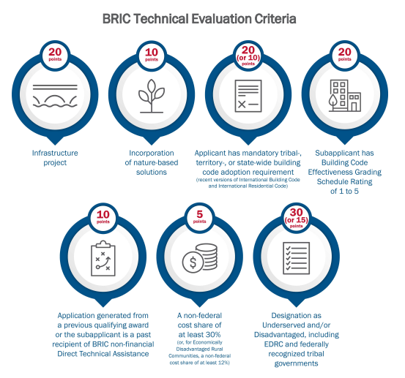
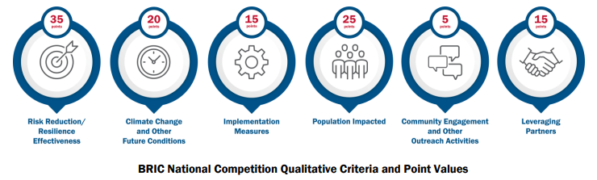
BRIC Category-Competitive
National competition
  States and tribes may submit an unlimited number of mitigation projects to compete for funding nationally
  Federal share capped at $50M per subapplication
  Ranking based on technical and qualitative criteria set by FEMA
Notes:
In FEMA policy, State is called the “Applicant”; local and state agencies that apply for project grants are referred to as “subapplicants”.
Receiving project scoping funding does not guarantee that future projects submitted as a result of the project scoping activity will be funded, however, as you will note in the evaluation criteria it will make it more competitive for funding
Note that phased projects are now eligible for BRIC.
Note that projects submitted under the state set-aside will be funded as long as they meet all other eligibility criteria for the program

Slide 20
HMGP Overview
Authorized by Section 404 of the Stafford Act, as amended
Available only after a federal major disaster declaration or Fire Management Assistance Grant declaration (to state)
Application period depends on declaration date
Competitive within state
State sets funding priorities
Reimbursement-based grant funded on a 75% federal 25% non-federal share basis

Slide 21
HMGP Application Process
State notifies potential HMGP sub-applicants
Sub-applicants submit pre-applications to State
State verifies project and applicant eligibility
If approved, sub-applicant completes full application and submits to State
State reviews full application and submits to FEMA
FEMA reviews and approves or denies full application

Slide 22
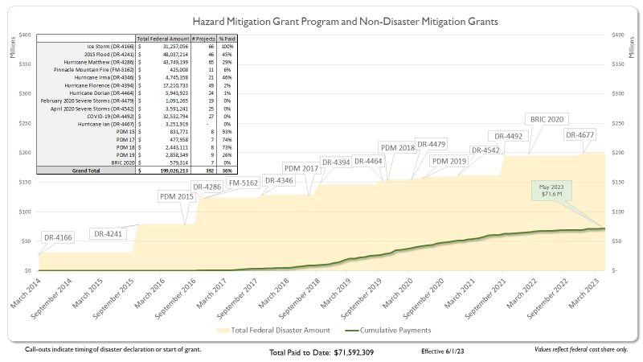
SCEMD Mitigation Grants Snapshot

Slide 23
Partnership Building Project
Awarded through the BRIC FY 2021 grant
Scope includes looking how to best use organic resources within SC
  More comprehensive technical support
  Leverage available funding opportunities
Partnerships with state agencies, institutions of higher education, PNPs, private sector, and local entities
Intended to support lower resourced entities in being more successful in completing mitigation projects

Slide 24
Overall Goal
The goal of hazard mitigation is to avoid or reduce damage, harm, and costs from future hazard occurrences.
Through mitigation planning and implementation of mitigation projects, state and local governments reduce future risk and make communities more resilient.

Slide 25
Contact Information
Candice Shealey
State Hazard Mitigation Officer
cshealey@emd.sc.gov
803-737-8682
mitigation@emd.sc.gov

