Slide 1

Engaging the Community in Productive Ways
Kendra Stewart
Advanced Leadership Academy 2024

Slide 2
Close your eyes…
What do you visualize when I say community participation?

Slide 3
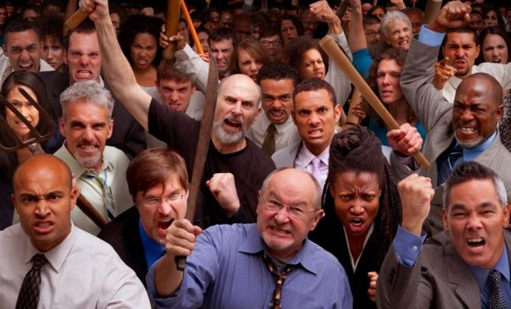

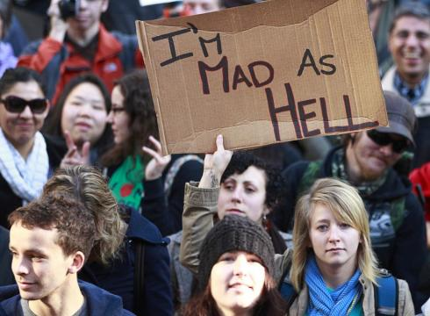
Community Participation

Slide 4
The Challenges of Participation
https://www.youtube.com/watch?v=gHB-NkYcXrQ

Slide 5
People are Looking for Opportunities for Purposeful Involvement
86% of respondents believe it is important for purposeful involvement in local government
Only 18% of those who Agree Public Service needs are met regularly attend Public Meetings, but 39% who Disagree their needs are met do so
Only 30% of those who regularly attend public meetings feel like public sentiment is considered in the decision-making process
Notes:
Even the majority of people who do not attend meetings think it is important for purposeful involvement – meaning they don’t find meetings provide that opportunity.

Slide 6
Why Encourage Engagement?
Required by law
Increases accountability/transparency
Increases use of services
Makes government more efficient
Can improve decision-making
Increases citizen buy-in and trust

Slide 7
What is Resident Engagement?
“Citizen engagement focuses on revitalizing democracy, building citizenship, and reinforcing a sense of community, and it cannot be equated with one-way exchanges between government and citizens.”
-Jim Svara and Janet Denhardt
https://icma.org/documents/connected-communities-local-governments-partner-citizen-engagement-and-community-building

Slide 8
Core Values of Participation IAP2
Public participation is based on the belief that those who are affected by a decision have a right to be involved in the decision-making process.
Public participation includes the promise that the public's contribution will influence the decision.
Public participation promotes sustainable decisions by recognizing and communicating the needs and interests of all participants, including decision makers.
https://www.iap2.org

Slide 9
Core Values of Participation IAP2
Public participation seeks out and facilitates the involvement of those potentially affected by or interested in a decision.
Public participation seeks input from participants in designing how they participate.
Public participation provides participants with the information they need to participate in a meaningful way.
Public participation communicates to participants how their input affected the decision.

Slide 11
ICMA Local Government Survey
2012 2017
Inform 85% 75%
Consult 75% 60%
Involve 70% 69%
Collaborate 57% 56%
Empower 19% 19%

Slide 12
So – how do you do this?

Slide 13
What are you doing?
Take a moment to complete the self-assessment

Slide 14
Take-Aways
Public engagement is a continuous task
Falls on the shoulders of everyone in public service
Meaningful participation has a positive effect on programs
Engagement done well improves the quality of life for everyone and strengthens social bonds and human capital
Solutions will not be perfect, but silence is destructive
Stay in the game: ask hard questions, embrace diverse viewpoints, implement the best ideas, monitor results, and make adjustments
Remember - People Care!

