Slide 1
Passport Application
Acceptance Program

Slide 2
Introduction
Passport Services is a directorate of the Bureau of Consular Affairs within the U. S. Department of State. Passport Services is responsible for issuing passports to eligible U. S. citizens and ensuring the integrity of the U. S. Passport.
By statute, the Secretary of State has the authority to grant and issue U. S. Passports. Passport Services designates public sector entities to accept passport applications and ensure the integrity of the passport.
Your participation in the Passport Application Acceptance Program is critical in helping us fulfill the Mission of Passport Services.

Slide 3
Mission of Passport Services
The mission of Passport Services is to issue secure travel documents while providing the highest level of customer service, professionalism and integrity. This is accomplished through the regional passport agencies and network of approximately 7460 public sector offices throughout the United States and its Territories, that are designated to accept passport applications. These offices are referred to as “Passport Acceptance Facilities” and are a critical component of the Passport Acceptance Program.

Slide 4
Passport Services Network
Passport Services is comprised of the regional passport agencies and centers, the headquarters office in Washington, DC, and two customer contact centers in Lansing Michigan and Phoenix Arizona.
Servicing U. S. citizens are approximately 7460 conveniently located passport acceptance facilities nationwide. The vast majority of customers who apply for a passport do so in-person at a passport acceptance facility near where thy live or work. It is through these facilities and their passport acceptance agents, that the Department of State is able to provide quality service to our customers efficiently and effectively. In addition to the passport acceptance facilities, customers traveling with two weeks or less may apply in-person at one of our regional passport agencies or centers located strategically throughout the country.

Slide 5
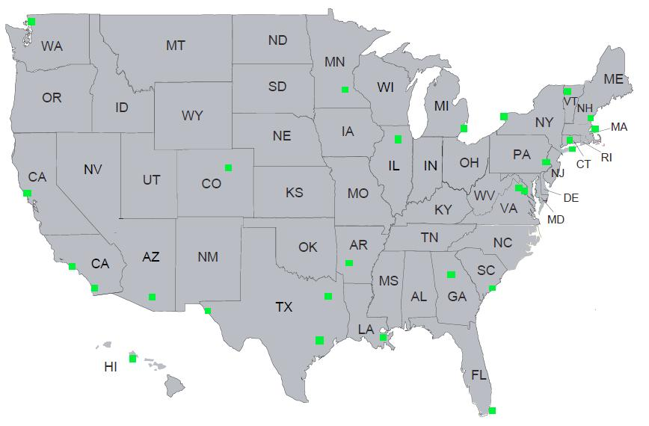
Passport Agencies and Centers
There are 28 strategically located passport agencies throughout the United States, as well as five high-volume passport centers, two printing facilities and one Special Issuance Agency.

Slide 6
Did you know?
For Americans traveling outside the United States, the U. S. Passport is the only singular document that serves as both identification and proof of U. S. citizenship and is recognized around the world.
During fiscal year 2022 approximately 1 million travelers had their passport application accepted from acceptance facilities that were located across the Charleston passport Center’s four-state region of Kentucky, North Carolina, South Carolina and Tennessee.
The demand for passports are projected to remain at a steady incline annually.

Slide 7
How do I benefit?
Providing a vital service in your community of fellow Americans
Retaining the $35.00* acceptance fee for each passport application
Building relationships with Congressional offices and staffers
Also creating possibilities of partnering with USCIS to provide passport information to newly naturalized citizens
Working with local colleges/universities to provide passport acceptance opportunities to students with passport fairs
*The acceptance fee is subject to change.

Slide 8
How Does This All Work?
The following is an overview of a typical first-time routine passport applicant’s process from start to finish. Some stages of the process may differ depending on workload, location, or other factors.
A customer comes into an acceptance facility to apply for a U.S. passport. The Acceptance Agent collects the completed Form DS-11, Application for a U.S. Passport, a 2”x2” passport photograph, a certified U.S. birth certificate as evidence of U.S. citizenship, a driver’s license as evidence of identity (with accompanying photocopy), and two checks for payment: one to the acceptance facility for accepting the application, and another made out to the U.S. Department of State for the passport fees.
1.

Slide 9
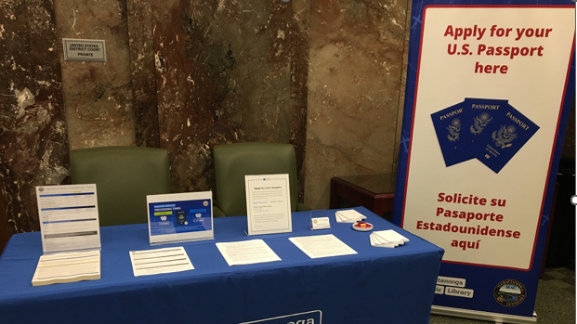
Accepting Applications

Slide 10
Scenario
2.
The acceptance agent notates the identification, returns the evidence of identity, and administers the passport oath. The applicant attests to the information on the application and then signs the application. The acceptance agent collects the passport fees, then signs and stamps the application. This is now a legally-binding document.
Each passport application is logged on a transmittal form and temporarily stored in a secure location. At the end of the day, all applications are sent via traceable mail to a secure lockbox facility. (A bank provides lockbox services via a U.S. Treasury contract.) It is here that passport fees are deposited, data from applications is entered, and the applications and photograph are electronically scanned.
3.

Slide 11
Scenario
4.
Applications are then shipped to a regional passport agency. The application data and scanned photo images are sent electronically. Applications are batched together for efficient processing and photos are checked for quality.
Applications are then adjudicated by Passport Specialists. This is a detailed process where specialists review all the information on the application, evidence of citizenship and identity, and any other corresponding documents to determine if the applicant is eligible to receive a U.S. passport. If all of the requirements are met, the specialist will notate the documents submitted and stamp the application to indicate approval.
5.

Slide 12
Scenario
6.
The application data is then transmitted electronically to one of Passport Services’ two printing facilities located in Hot Springs, Arkansas and Tucson, Arizona. The printing facility will print the passport, perform quality assurance checks, and mail out the applicant’s new passport book and/or passport card. The originating passport agency then receives an electronic confirmation, notifying that they may now release and return the applicant’s original documents.
The originating passport agency will then return the applicant’s evidence of citizenship, and send the original application to Record Services in Washington, DC for permanent archival.
7.

Slide 13
Interested?
First, make certain that your facility is eligible to be a Passport Acceptance Facility. Your facility must meet all of the following requirements:
Is a public sector entity (Federal, state, county, city, municipal office)
Is not managed or directly affiliated with a non-profit, religious, or commercial (private sector) entity

Slide 14
Interested?
Second, make certain that your facility has enough resources and accessibility to the public to take on this important commitment. We require that passport acceptance service is available during all hours of operation. Employees at your facility are eligible to accept passport applications if they meet all of the following requirements:
Are eighteen years of age or older
Are U.S. citizens or U.S. nationals
Are permanent full-time or part-time employees (not temporary, contractual, ad hoc, or volunteer)
Are not on parole or probation related to any Federal, State, or local felony or misdemeanor related to breach of trust or moral turpitude (i.e. embezzlement, document fraud, drug offenses, or dishonesty in carrying out a responsibility involving the public trust)
Are not presently under indictment for any Federal, State, or local felony or misdemeanor related to breach of trust or moral turpitude
Are free of any Federal, State, or local felony convictions or misdemeanor convictions related to breach of trust or moral turpitude

Slide 15
Passport Services provides
Direct email and phone support from the regional passport agency’s customer service staff
Forms and program-related materials and supplies
Passport Agent’s Reference Guide
Web-based and classroom training
Newsletters and updated from your regional passport agency
Invitations to participate in Passport Fairs and other outreach programs
An open invitation to visit your regional passport agency

Slide 16
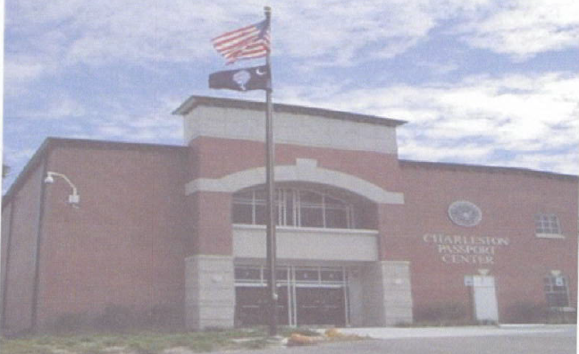
Charleston Passport Center

Slide 17
Contact Information
Regional Passport Agency: Charleston Passport Center
Contact Phone: 843-746-1760
Contact Email: CPC-AA@state.gov
DoS Acceptance Agent Program Manager
Customer Service Manager: John Lupton
Managers Phone: 843-746-1917
Managers Email: luptonjr@state.gov
Please note: The Department of State may only consider applications for designation based on certain criteria such as passport demand and existing acceptance facilities located in communities. Submission of the designation packet does not automatically grant enrollment to the Passport Acceptance Program. Your facility’s request for designation may be declined at the Department of States discretion.

Slide 18
Final Questions?

Slide 19
Non-Postal Acceptance Facility Endorsements
Edgecombe County Memorial Library, NC
Our library came onboard as a passport agency in 2017. We are in a small rural area and at that point, and still even now, there was no other passport facility in out county. When we started offering passport services we were blown away by the response from our community. Everyone in our area that had been having to travel to other counties and people from surrounding areas where it was harder to get appointments started coming to us. Our patrons have been very appreciative, and I am constantly being thanked for offering this service for the community. For the library it has also been a boon. The increased visibility and traffic in-and-out of the library has raised public awareness of us and what we offer. The revenue for the library from the passports has also been appreciated, especially over the past few years when fewer people were venturing out. Overall, becoming a passport acceptance agency has been a huge benefit to both the library and our community.
Brian Everett
Reference Assistant
Edgecombe County Memorial Library
252-823-1141

Slide 20
Non-Postal Acceptance Facility Endorsements
NC Central University, NC
Opening the Passport Office on our campus has significantly enhanced the accessibility of obtaining and renewing passports for our students, faculty, staff, and the local community. This establishment represents an asset for North Carolina Central University and strengthens our partnership with the Office of International Affairs.
NCCU students, faculty, staff, and local community members can now conveniently apply for or renew passports in person. Our office also provides on-site photo services for passports and country-specific visas. To ensure a streamlined experience, services at our facility are available by appointment only.
Furthermore, the in-person training, numerous passport fairs, and community outreach initiatives that we conduct are all effective advantages of having a non-postal passport facility. These efforts have allowed the NCCU Passport Office to assist countless applicants in obtaining passports.
Beyond the convenience, this initiative also generates significant revenue for non-postal facilities. We take pride in being recognized for our effective and efficient execution of passport applications and for delivering excellent customer service.
Thank you for your continued support.
Porsha D. Walker NCCU Passport Services Manager
Porsha D. Walker
Passport Office Manager
Office 919-530-7272 or 919-530-7472
passportservices@nccu.edu

Slide 21
Non-Postal Acceptance Facility Endorsements
Appalachian State University, NC
App State became a passport acceptance facility in the summer of 2010. Over the past 13 years we have seen steady increase of applications processed, not including the pandemic years. We started out generating 12-15k in yearly revenue. Last year App State generated 26k and we are on pace this year to break 30k. App State Post Office was looking at new opportunities to generate additional income and becoming a passport acceptance facility was a great way to generate income and give a service to the University/Boone community. Because of larger cities in and around NC being unable to keep up with demand, we have had customers come to Boone from across the State. Being a passport acceptance facility is rewarding and a great way to meet new people. If anyone needs additional information about our facility you are welcome to contact me.
Barry Stansberry
Director
Stansberrybi@appstate.edu
828-262-2246

Slide 22
Non-Postal Acceptance Facility Endorsements
USC Postal Service, SC
The University of South Carolina Postal Service has been an official Acceptance Facility since June 2016. As a US Dept Of State Acceptance Facility, it has been a huge benefit for our university community, and the public. Not only is it a large revenue stream, but offering a service that is much needed is very rewarding. Our staff thoroughly enjoys the interaction with each applicant. We strive to take some time to meet the applicants while collecting their documents. It ensures the applicant that their documents are assembled and submitted correctly. Our volumes have increased each year, and that is credited to the customer service we provide. Many applicants may fear the process of submitting documentation for a passport, but our staff takes pride in educating the customer about the process for a positive experience. The support from the US Dept. of State is well appreciated also. If there are any changes, or updates to procedures, the US Dept. of State will communicate to the acceptance facilities well in advance. It has been a very rewarding experience by being an acceptance facility, as we continue to provide a much-needed service.
Mike Adams
Director – USC Postal & Passport Services
Head of Facility – USC Passport Services
Adamsmc4@mailbox.sc.edu
803-777-2159

Slide 23
Non-Postal Acceptance Facility Endorsements
York County Clerk of Court, SC
A passport acceptance facility is a great connection to the community. It provides a service that is often hard for the public to understand and gives them a direct point of contact to help with the confusion of the passport process. Most of the time people do not associate a government entity with being a help to the community, but from working in the passport office I have seen how the community positively responds to the help/ service that is provided. As an acceptance agent I feel that I am an important factor in the passport process. We are there to provide guidance and knowledge so that the general public has the means and access to obtain a passport and travel the world for various reasons. I feel that we also are a help to the US Dept of State, as we are a first line of defense in getting the correct documentation to them so that the issuance of a passport process goes more smoothly, and the processing times are not as long.
Shawna Sandifer
Passport Program Manager
803-909-1893
SHAWNA.SANDIFER@YORKCOUNTYGOV.COM

Slide 24
Non-Postal Acceptance Facility Endorsements
Lancaster County, SC
Lancaster County is proud to offer the service of Passport reception. We feel we greatly benefit the business community in providing the service to ensure that their employees have the travel documents they need for their business travels. We also aide the community in offering another office close by to process their passport documents. We have applicants from surrounding communities in neighboring states as well as our local area to make appointments for this service.
We are here to answer any questions and offer additional assistance and information in processing applicants’ passport needs. We currently offer appointments only but will be opening a “walk in” service on Wednesdays shortly.
Kim Stroud
Passport Program Manager
803-416-9429
KSTROUD@LANCASTERCOUNTYSC.NET
Jennifer Page
803-416-9334

Slide 25
Non-Postal Acceptance Facility Endorsements
Chattanooga Public Library, TN
The Chattanooga Public Library, as a Passport Acceptance Facility, has had the privilege of providing passport services since 2006. Through the years we have created valuable partnerships with local organizations such as La Paz Chattanooga (a Hispanic outreach and social services organization), the City of Chattanooga's Multicultural Office, Chattanooga State Community College, and the University of Tennessee at Chattanooga.
We are extremely fortunate to have a bilingual Passport Facility Manager. We are able to reach a vastly under-served Hispanic population. Our manager connects Hispanic passport applicants with other community services, such as Translation services and Immigration offices. As a Spanish speaker and a library specialist, she provides important information otherwise inaccessible to them.
Through our representation at the Federal Court’s Naturalization ceremonies, we have expanded our exposure beyond the community we serve. People come to Chattanooga to be naturalized from all over East Tennessee, and they stay in town following the ceremony to apply for a passport at our library. Through our outreach programs we strive to reinforce our importance to the politicians who control our funding. Providing excellent service to their constituent’s benefits everyone. We regularly work with congressional offices to expedite passport applications for urgent travelers. We have developed a reputation as passport problem-solvers.
Libraries have always played a vital role in the community. By also serving as a Passport Acceptance Facility, the Chattanooga Public Library has reached a new audience. Applicants who do not have library cards can see first-hand what our library has to offer.
Carol Guerra 082199
Passport Coodinator
Chattanooga Public Library
cguerra@lib.chattanooga.gov
P: 423-643-7724

Slide 26
Non-Postal Acceptance Facility Endorsements
Spartanburg County Public Library, SC
Spartanburg County Public Libraries becoming a passport acceptance facility has been a beneficial opportunity for the library and, most importantly, the people of Spartanburg County. Over the last several years the number of patrons looking to apply for passports has steadily increased. Accepting passport applications at the library has helped us provide an additional avenue to meet this additional community need. The program has helped bring in new patrons and introduced them to the variety of services and programming the library offers before and after they go through the passport acceptance process.
Since the program began at the library it has steadily grown from two agents to a team of five agents, and soon to be seven agents. The program has become a fixture of the Information Services department and become a consideration for the department’s long-term strategic planning. This past fiscal year the program earned $52,515.20 which helped offset mailing, supply, administrative, and other operational costs. Spartanburg County Public Libraries has fully embraced passport acceptance services and is glad to continue providing these services to the community.
John Fowler
Assistant Director of Information Services
Spartanburg County Public Libraries (864) 285-9154, ext. 9154
www.spartanburglibraries.org

