Slide 1




Create a High-Performance
Culture
Presented By:
Christopher McKinney Sr.
Founder/CEO:
10X Leadership Consulting
Author: Triumphant Transitions
Keynote Speaker

Slide 2



















Slide 3










•
•
•
•

Slide 4


Helping government & business run better.

Slide 5









Slide 6











Slide 7
TOXIC CULTURE STATICS
Helping government & business run better.

Slide 8










•
•
•
•
•
•
•
•

Slide 9







•
Leaders spend
hours weekly dealing with conflict
•
•
•
•

Slide 10









Slide 11
11 meta-analyses converged on the same three factors as the most powerful predictors of toxic behavior in the workplace: 1) toxic leadership 2) toxic social norms (culture) 3) poor work design.

Slide 12
IMPACT OF TOXIC CULTURE
Helping government & business run better.

Slide 13




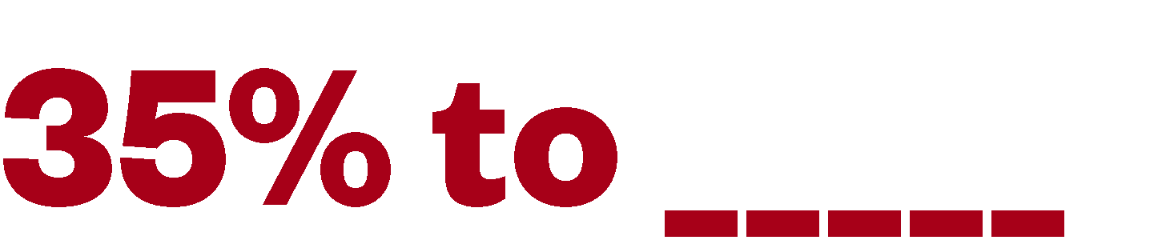
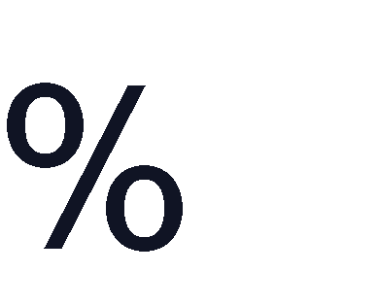



Slide 14
















•
•
•
•
•
•

Slide 15

















Slide 16










Slide 17




Slide 18









•
•
•
•

Slide 19

















▪
▪
▪
▪
▪
▪

Slide 20





•

Slide 21




•
•

Slide 22






•
•
•

Slide 23
WHY CULTURE MATTERS TO YOU
Helping government & business run better.

Slide 24




Slide 25








Slide 26





Slide 27


Slide 28










Helping government & business run better.

Slide 29












Slide 30




•
•

Slide 31
WHAT IS A
HIGH-PERFORMANCE CULTURE
Helping government & business run better.

Slide 32

















•
•
•

Slide 33



















•
•
•

Slide 34













•
•
•
•
•

Slide 35
IMPACT OF A
HIGH-PERFORMANCE CULTURE
Helping government & business run better.

Slide 36





















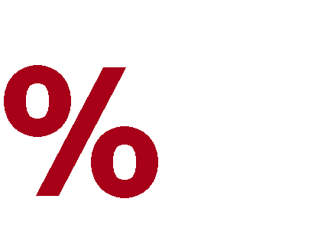



Slide 37






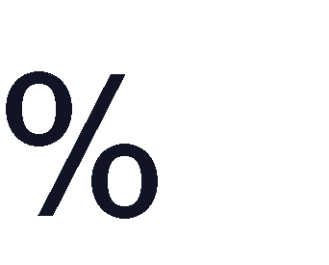





Slide 38
WHAT DOES A
HIGH-PERFORMANCE CULTURE LOOK LIKE
Helping government & business run better.

Slide 39
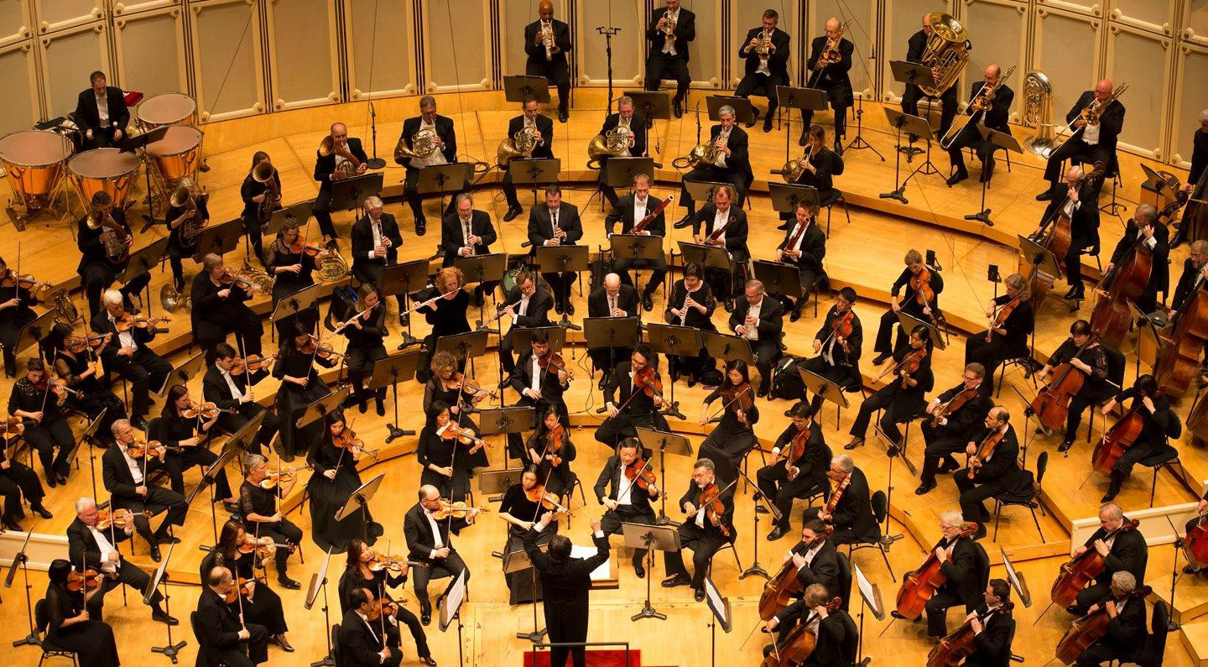

Slide 40
HOW TO BUILD A HIGH-PERFORMANCE CULTURE
Helping government & business run better.

Slide 41

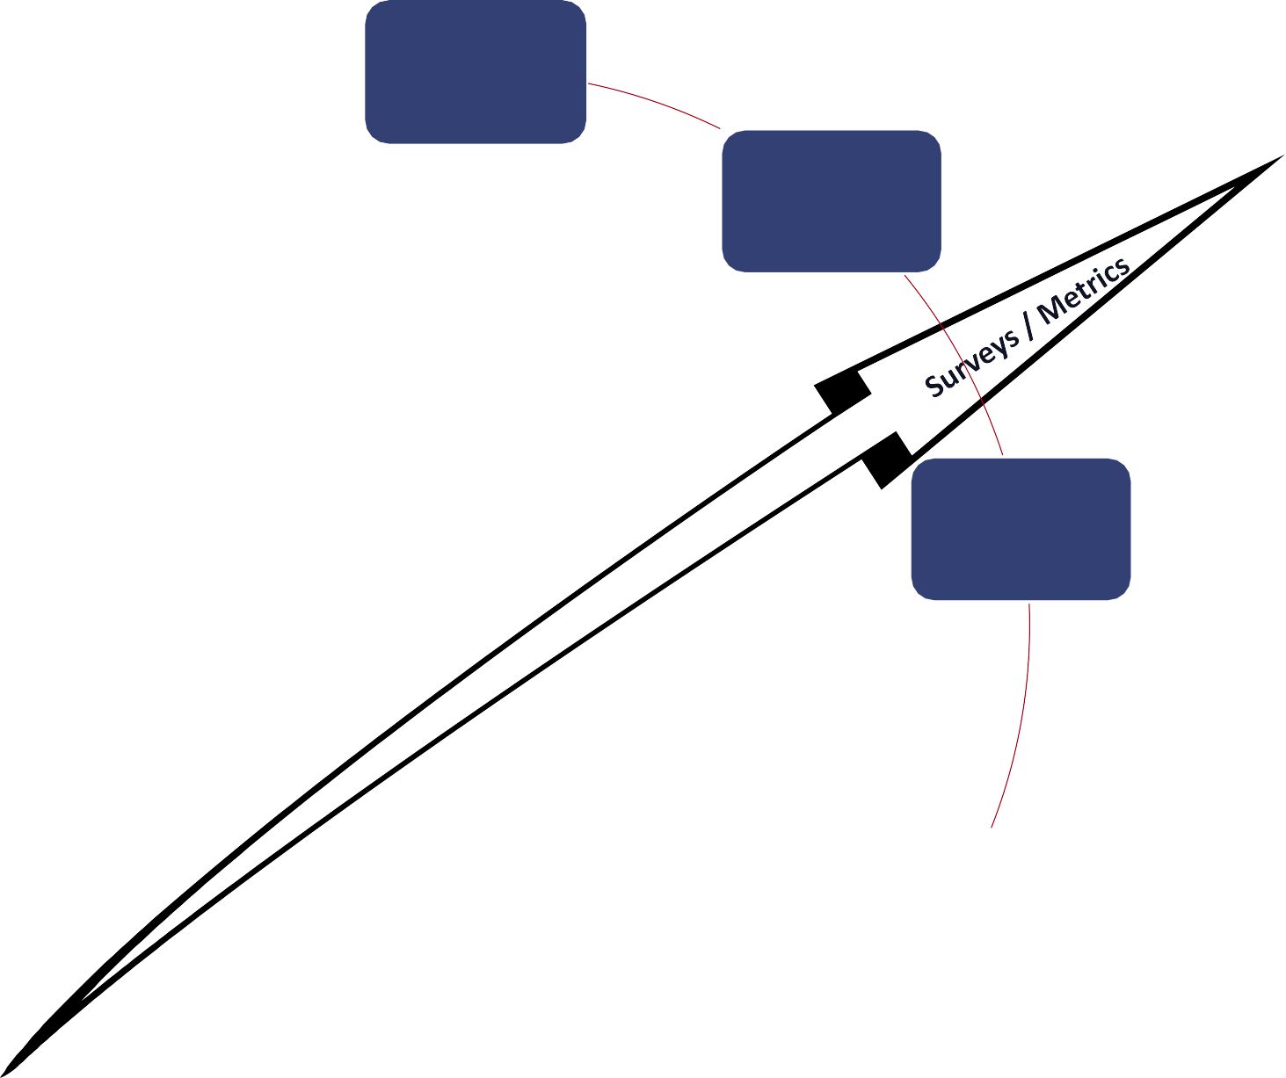



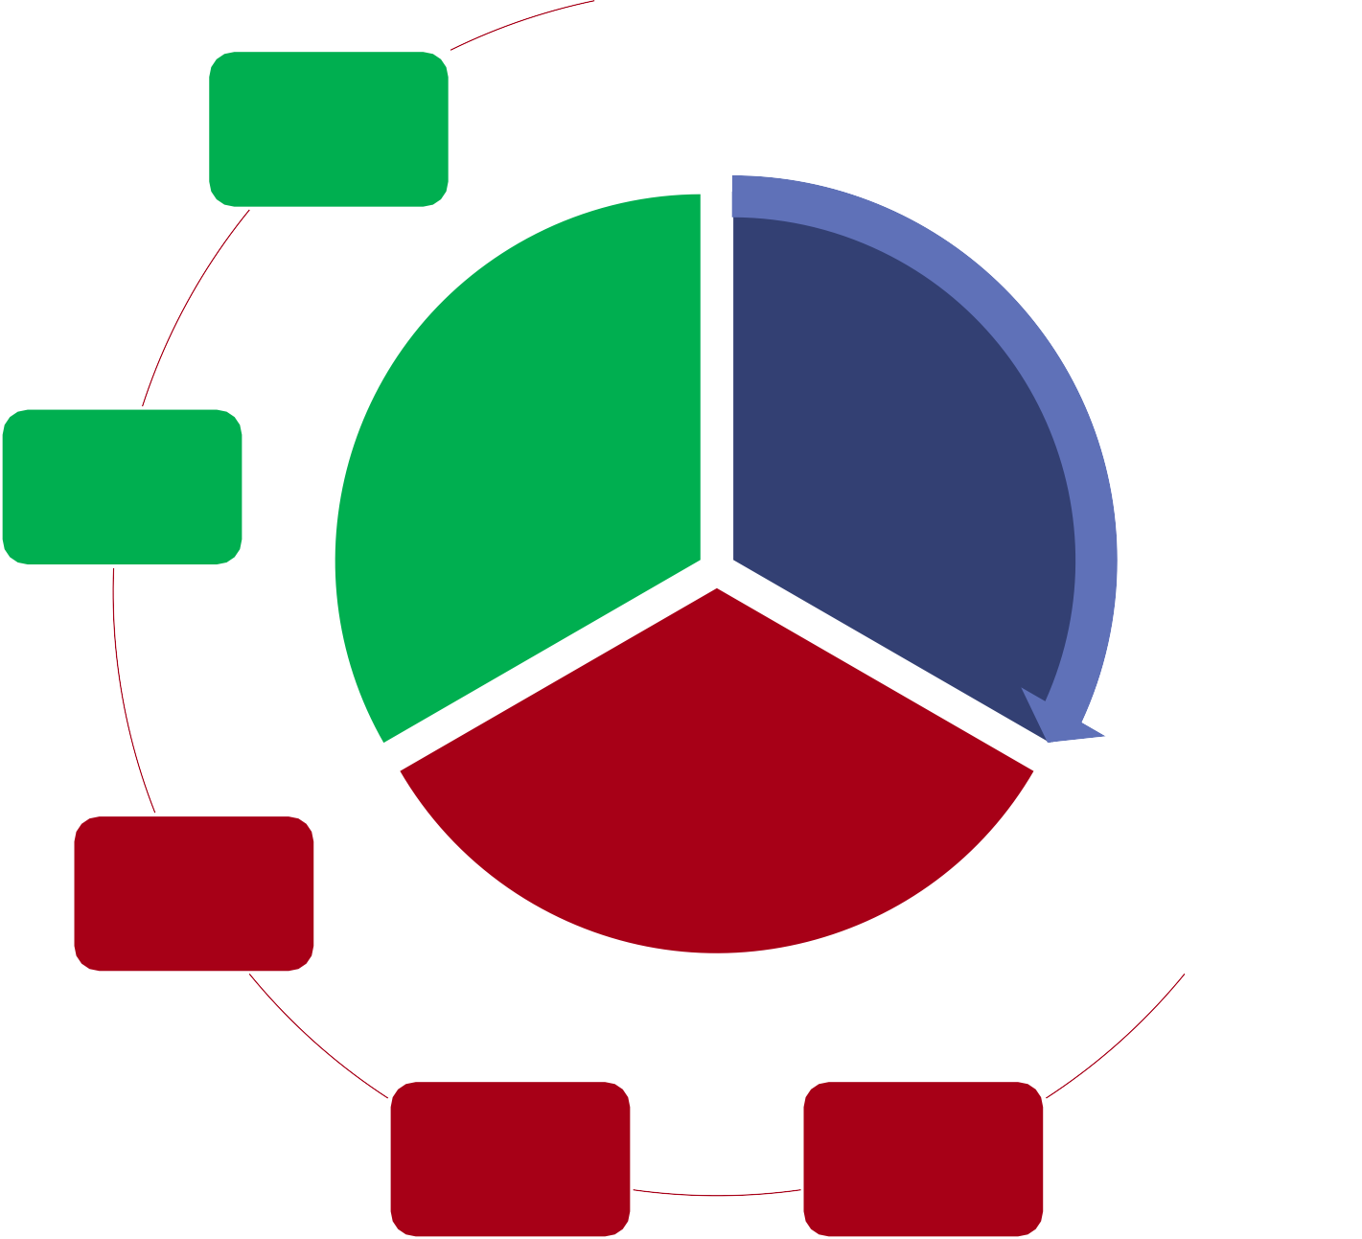


Clear Communication
Human Development
Change Management
Total Employee Involvement
Team Development
Leadership
Servant Leadership
Total Employee
Engagement
Assess & Renewal
Common Vision
Continuous
Improvement
Reward &
Recognition

Slide 42
ONGOING CULTIVATION & GROWTH
Helping government & business run better.

Slide 43





•
•
•
•
•

Slide 44
















•
•
•
•
•
•
•

Slide 45






•
•
•

Slide 46


Slide 47





Slide 48


Assessment – Consultation - Workshop
.
Helping government & business run better.

Slide 49














