Slide 1
Teaming with the Office of State Procurement
Notes:
Finance and procurement work together on a regular basis to ensure our entities’ needs are met. Identifying efficiencies can make everyone’s life better, and state term contracts are a great way to recognize contracting proficiencies. Knowing where to find state term contracts and identifying who to call when you have a need or question can be a challenge. In this session, we will discover tips and tricks to find existing contracts while also identifying the information necessary when our office considers new state term contracts. Updates on our newest contracts will be provided and a question-and-answer period will be included for those things you would like to know more about. Join this session to discover many ways to team with the Office of State Procurement!

Slide 2
Getting to Know You
Does anyone have an unlimited budget?

Slide 3
Getting to Know You
Who has more resources than you know what to do with?

Slide 4
Getting to Know You
If we could help you identify ways to do more with less, saving both time and money, would you be interested?

Slide 5
Poll Question
How many of you are familiar with the Office of State Procurement & State Term Contracts?

Slide 6
Objectives
Identify efficiencies through State Term Contracts
Recognize State Procurement’s organizational structure and identify who to contact based on your needs
Find open solicitations and existing contracts
Navigate the State’s Procurement Services Website
Provide State Term Contract updates

Slide 7
What does the Office of State Procurement do?
Establish state term contracts for governmental bodies to use.
Establish agency contracts for State agencies above their certification limits.

Slide 8
Office of State Procurement Structure
Agency Sourcing Teams
Human Services / Other Agencies
Higher Education / Law Enforcement
Information Technology

Slide 9
Office of State Procurement Structure
State Term Contracting Teams
Goods & Services
Information Technology

Slide 10
Primary Goals of the State Term Contracting Team
Identify Contracting Opportunities
Acquisition Planning
Strategic Sourcing of State Term Contracts
Monitoring Contract Performance

Slide 11
Why Utilize State Term Contracts?
Save
Time
&
Money!

Slide 12
Increase savings
Buy in bulk & ask vendor for additional discounted pricing.

Slide 13
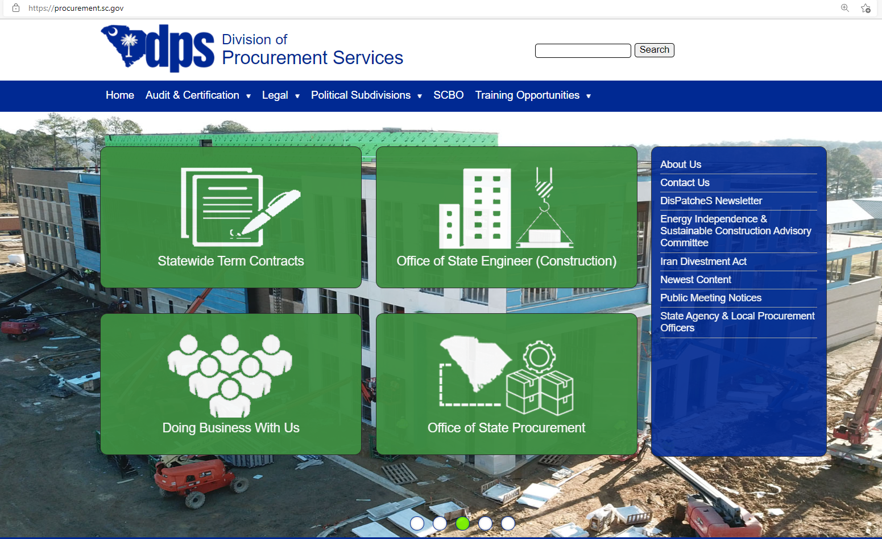
Access State Term Contracts
www.procurement.sc.gov

Slide 14
Access Statewide Term Contracts
https://www.procurement.sc.gov/contracts

Slide 15
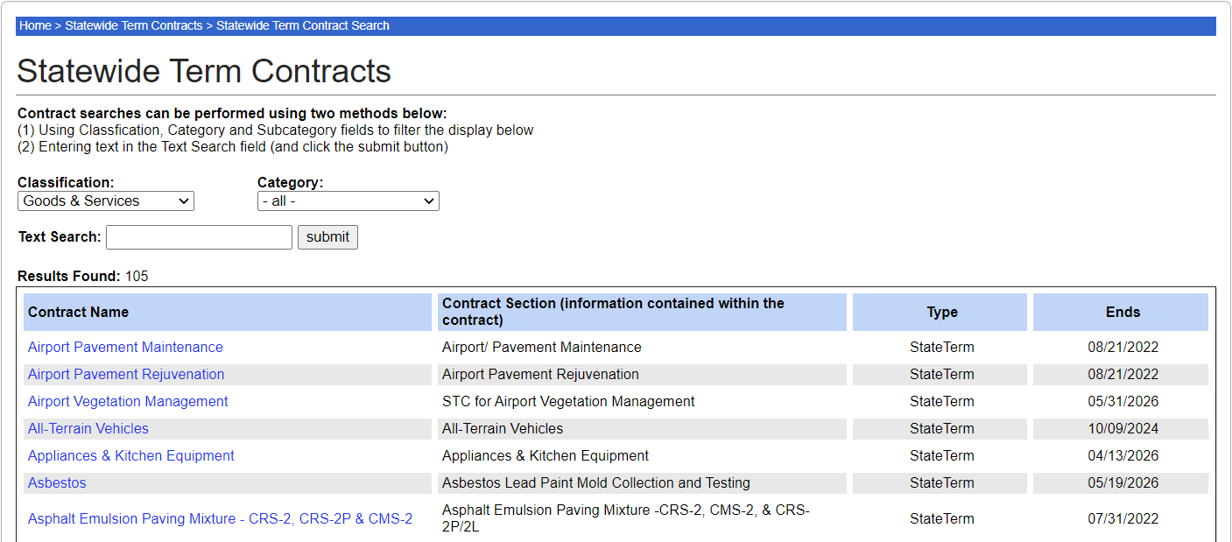
Access State Term Contracts
www.procurement.sc.gov

Slide 16
Great demand?

Slide 17
Identifying Contracting Opportunities
Anticipated Users
Anticipated Volume
dollars
& quantity
Continued Need
Market Stability
Level of Competition

Slide 18
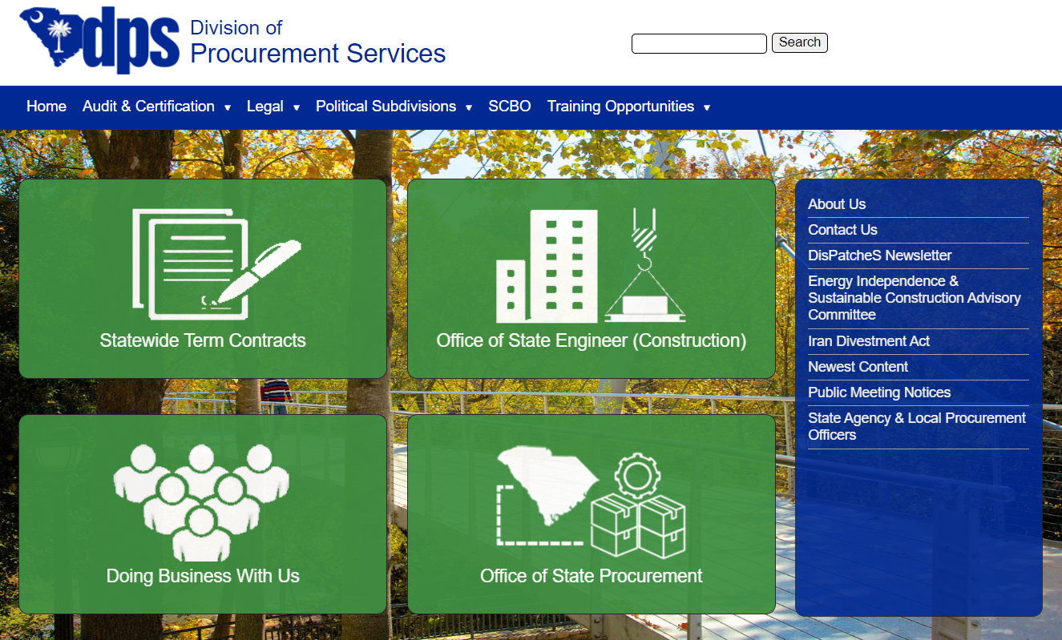
DisPatcheS Newsletter
www.procurement.sc.gov

Slide 19
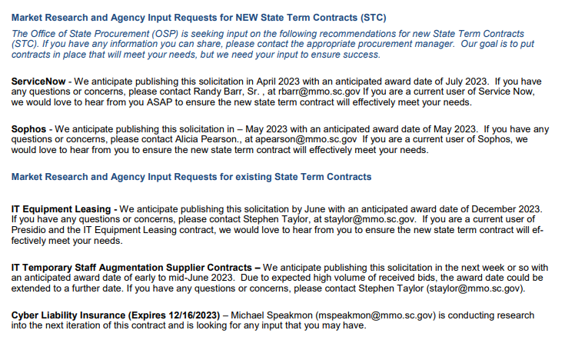

Slide 20
South Carolina Business Opportunities
www.procurement.sc.gov

Slide 21
https://scbo.sc.gov/online-edition

Slide 22
Contact Us or Other Agency Procurement Officers
www.procurement.sc.gov

Slide 23
Where can I find more information about state government procurement?
www.procurement.sc.gov

Slide 24
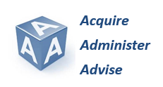
How can we serve you best?
We Are Always Willing To Help
Call Us at 803-737-0600
Visit our Website - www.procurement.sc.gov

Slide 25
Poll Question
If you have learned at least 1 thing that will help make your job, or your interaction with our office easier, will you raise your hand?
Notes:
I love to get feedback so thank you!

