Slide 1
South Carolina Economy, Budget, & Revenue Update PRESENTED TO South Carolina City and County Management Association June 17, 2022
Frank A. Rainwater
Executive Director
South Carolina Revenue and Fiscal Affairs Office
frank.rainwater@rfa.sc.gov | 803.734.1519

Slide 2
Economy “I see the bad moon a-risin’ I see trouble on the way I see earthquakes and lightin’ I see bad times today …” - Creedence Clearwater Revival, “Bad Moon Rising”

Slide 3
Inflation Rates Inflation reached 8.5 percent in March 2022, the highest rate since 1981

Slide 4
Interest Rates The Federal Reserve is expected to raise interest rates six times in 2022 to curb inflation; economic analysts are predicting more modest rate hikes in 2023
Source: Board of Governors of the Federal Reserve System, Federal Funds Effective Rate; Federal Open Market Committee, March 16, 2022: FOMC Projections materials; Trading Economics, United States Fed Funds Rate Forecast for 2023, nmg/4/13/2022

Slide 5
Wage Growth and the Labor Market Wage growth remains elevated; return to normal levels may be more gradual than expected as the labor shortage continues

Slide 6
SC Employment Job growth slowed in March after a strong February, although employment remained above pre-pandemic levels

Slide 7
US Unemployed Persons per Job Opening There are currently more job openings than unemployed persons; the tight labor market continues to drive up wages

Slide 8
SC Personal Income Persistent wage growth will keep personal income above trend through the forecast period

Slide 9
SC Consumer Spending Net taxable sales in the first half of FY 22 have grown nearly four times the average rate
Growth Rate: 11.9%
Average Growth Rate: 2.7%
Source: South Carolina Department of Revenue, nmg/3/30/2022

Slide 10
Lottery Sales Lottery sales peaked with first, second, and third rounds of stimulus
Source: South Carolina Education Lottery Commission

Slide 11
Revenues “You always keep me guessin’, I never seem to know what you are thinkin’ And if a fella looks at you, it’s for sure your little eye will be a-winkin I get confused ‘cause I don’t know where I stand …” - Atlanta Rhythm Section (cover), “Spooky”

Slide 12
February 2020 - Pre-pandemic General Fund revenues were slightly above the long-term trend

Slide 13
February 2021 - One Year into the Pandemic General Fund revenues were within the long-term trend
Pandemic

Slide 14
May 2022 – Two Years into the Pandemic General Fund revenues are significantly above the long-term trend
Pandemic

Slide 15
General Fund – Actuals vs. Estimates Revenues are growing faster than expected and are $444 million above the estimate year-to-date

Slide 16
General Fund Revenue Estimates Revised estimates assume higher peak in FY 2022; FY 2023 still anticipates a decline and return to normal levels

Slide 17
Non-Withholdings - Actual vs. Estimate Collections are 64.1% above last year, partially due to timing changes in tax filing season

Slide 18
Top South Carolina Tax Credits State tax credits totaled an estimated $930 million in 2020, with the top five credits by amount claimed accounting for 73.4% of the total

Slide 19
SC State Housing Tax Credit – Estimated General Fund Reduction

Slide 20
State Top Marginal Income Tax Rates South Carolina had the 11th highest top marginal individual income tax rate in 2018
Source: The Federation of Tax Administrators from various sources. Note: Tax rates shown are for 2018 for consistency with the effective tax rates. For later comparisons, GA top tax rate for 2020 is 5.75%; NC top tax rate for 2020 is 5.25%

Slide 21
State Average Effective Income Tax Rates South Carolina’s effective individual income tax burden falls below neighboring states
Source: IRS, Statistics of Income Division, Individual Master File System, Tax Year 2018 returns. Calculations by the S.C. Revenue and Fiscal Affairs Office.

Slide 22
Tax Liability Comparison – Tax Year 2020 Single

Slide 23
Tax Liability Comparison – Tax Year 2020 Married filing jointly family of four
SC/GA Breakeven: $120,512
SC/NC Breakeven: $92,723

Slide 24
Tax Liability Comparison – Tax Year 2020 Head of household and two dependents

Slide 25
Tax Liability Comparison – Tax Year 2020 65+ single with a maximum of $10,000 in federally taxable Social Security benefits*
*Assumes 40% of all non-Social Security income comes retirement income and 60% comes from earned income. For Georgia, up to $65,000 of retirement income, which can include up to $4,000 in earned income, can be deducted. Social Security income totals $11,764.71 in this scenario; at most, $10,000 of this can be taxed at the federal level.

Slide 26
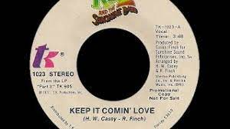
Budgets Keep it comin’ love, Keep it comin’ love Don’t stop it now, don’t stop it no Don’t stop it now, don’t stop it … Don’t let your well run dry Don’t stop it now Don’t give me no reasons why … Don’t build me up just to let me drop Don’t stop it now - KC and The Sunshine Band, “Keep it Comin’ Love”

Slide 27
Available Funds – FY 2022-23 Budget Process

Slide 28
General Fund Revenue Long Range Outlook Revenue collections are not expected to reach the FY 2022 peak again until FY 2025

Slide 29
General Fund Revenue Growth General fund revenue growth is expected to peak in FY 2022 at $1.7 billion; FY 23 revenue estimate well above FY 22 expenditure base

Slide 30
Millage Rate Increase Limitation Issues
2020 Census impact
FY 2022-23 range:
Counties: 4.7% to 9.0%
Municipalities: 4.7% to 20.0%
Wells Fargo’s June 2022 forecast projects inflation will be 8.2% this year, which would be reflected in next year’s millage caps

Slide 31
Resources at RFA “Ain’t it good to know you’ve got a friend Ain’t it good to know, ain’t it good to know Ain’t it good to know, you’ve got a friend” - Carole King, You’ve Got A Friend

Slide 32
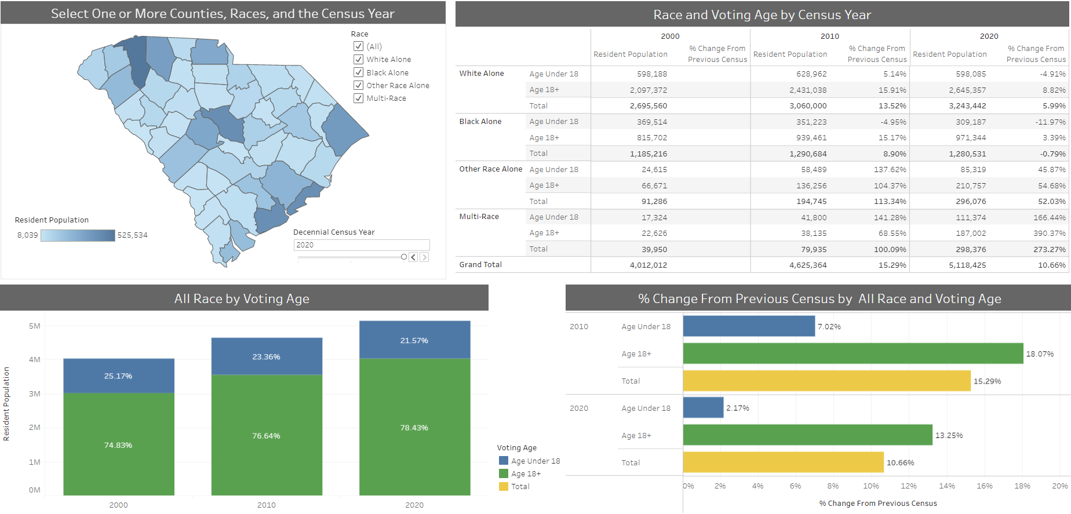
Census Dashboards

Slide 33
Locate Me https://rfa.sc.gov/mapping/locate-me

Slide 34
SC Aerial Imagery https://www.arcgis.com/apps/mapviewer/index.html?layers=1a3f8aa93e674dcd93396b8d2c11e490

Slide 35
On the Horizon
Public Education Funding and Accountability Dashboard
County Boundaries
Long-term population projections
2030 Redistricting planning and training sessions

Slide 36
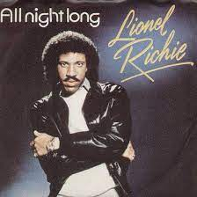
Conclusion & Questions
“Well, my friends, the time has come To raise the roof and have some fun Throw away the work to be done …”
- Lionel Richie, “All Night Long”

