Slide 1

SCDOT Update
SCCCMA Summer Meeting
June 2022

Slide 2

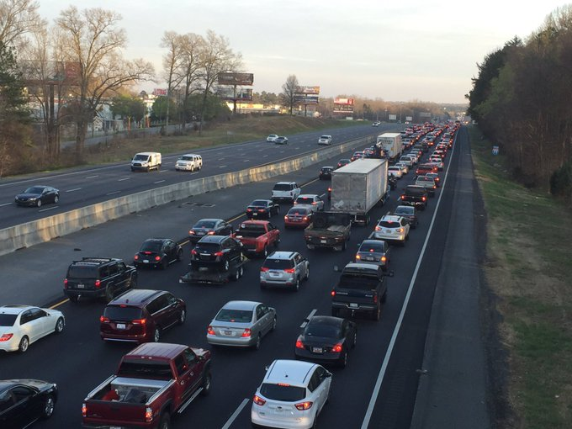
4th largest state highway system in the United States
serving the
10th fastest population growth rate
in the United States.

Slide 3
Bottom Line Upfront:
Excellent progress is being made towards getting to a state of good repair.
Now we must incorporate projects to deal with the growth and economic development needs of our state.

Slide 4
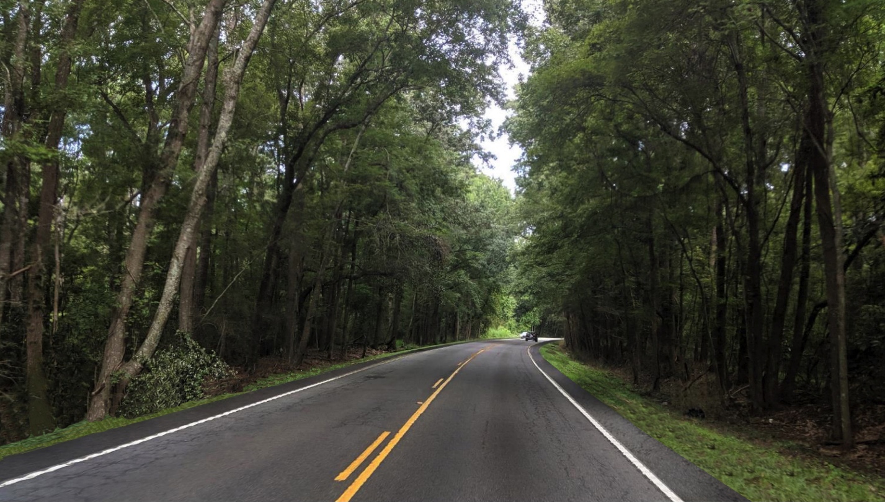
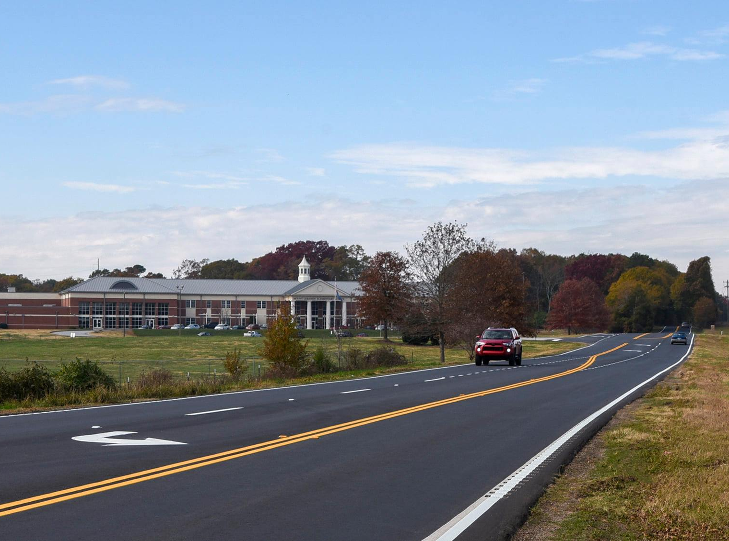
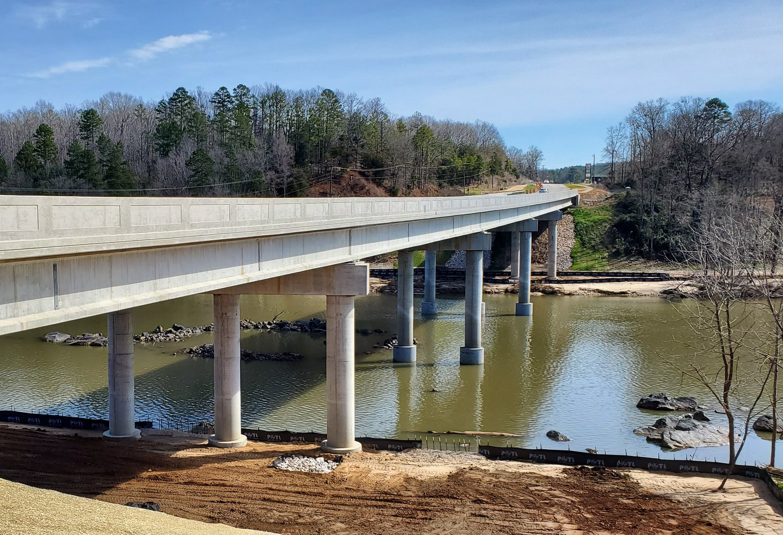
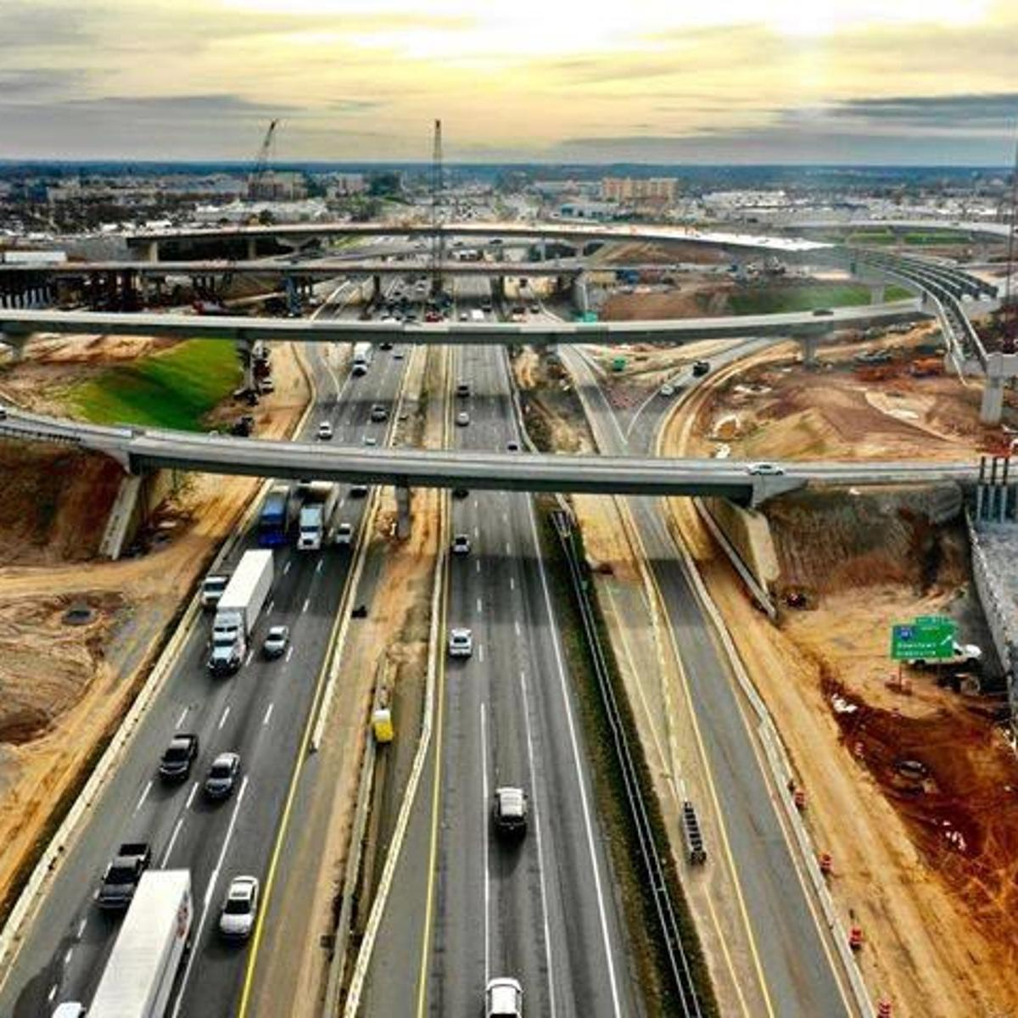
SC dramatically increased Road and Bridge funding in 2017 which enabled the launching of a Strategic 10-Year Plan to repair and make some upgrades to the transportation network.
Rural Road Safety
Paving
Bridges
Interstates

Slide 5
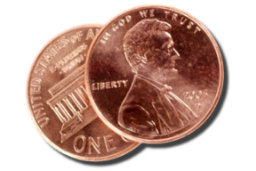
The final 2¢ of the gas tax increase will occur July 1, 2022
38.75¢
28.75¢
On 7/22
29.1¢ Gas
32.6¢ Diesel
1¢ generates ≈ $36 Million

Slide 6
Road and Bridge Construction in SC has Tripled
$3.5B
$1B

Slide 7
10-Year Plan Accomplishments
Rural Road Safety
Paving
Bridges
Interstates
722 miles
New Target of 1250 miles
>5800 miles
Pavements measuring
% Good have doubled
235 bridges
New Target of 500 bridges
80 miles
Minimum of 140 miles Targeted

Slide 8
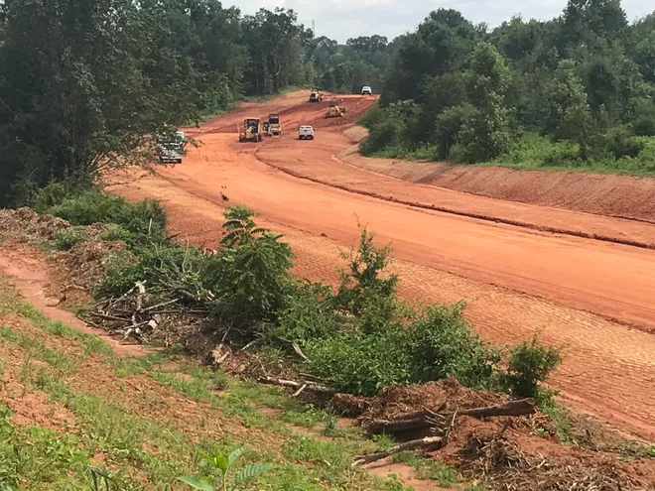
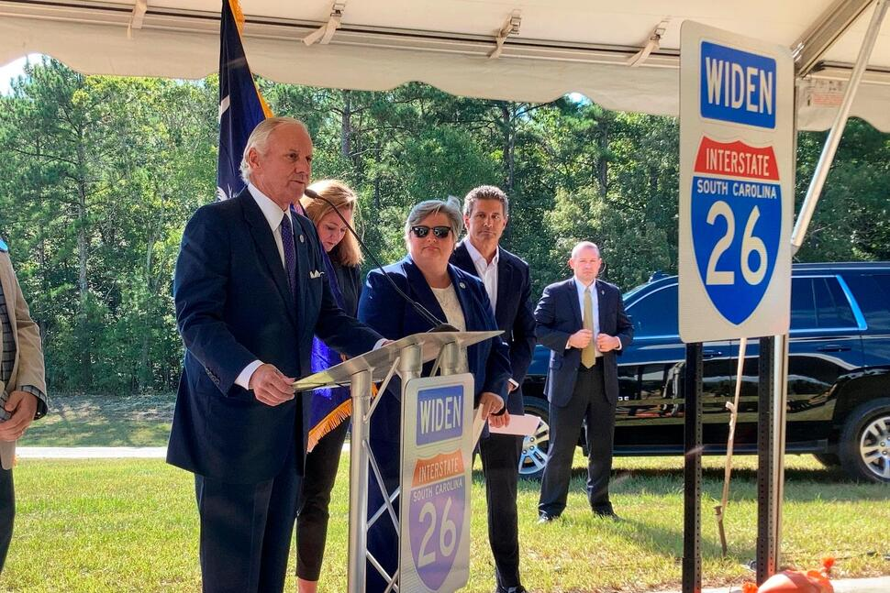
Increased federal funds give us the opportunity to incorporate projects into our 10-Year Plan to deal with the growth and economic development needs of our state.

Slide 9
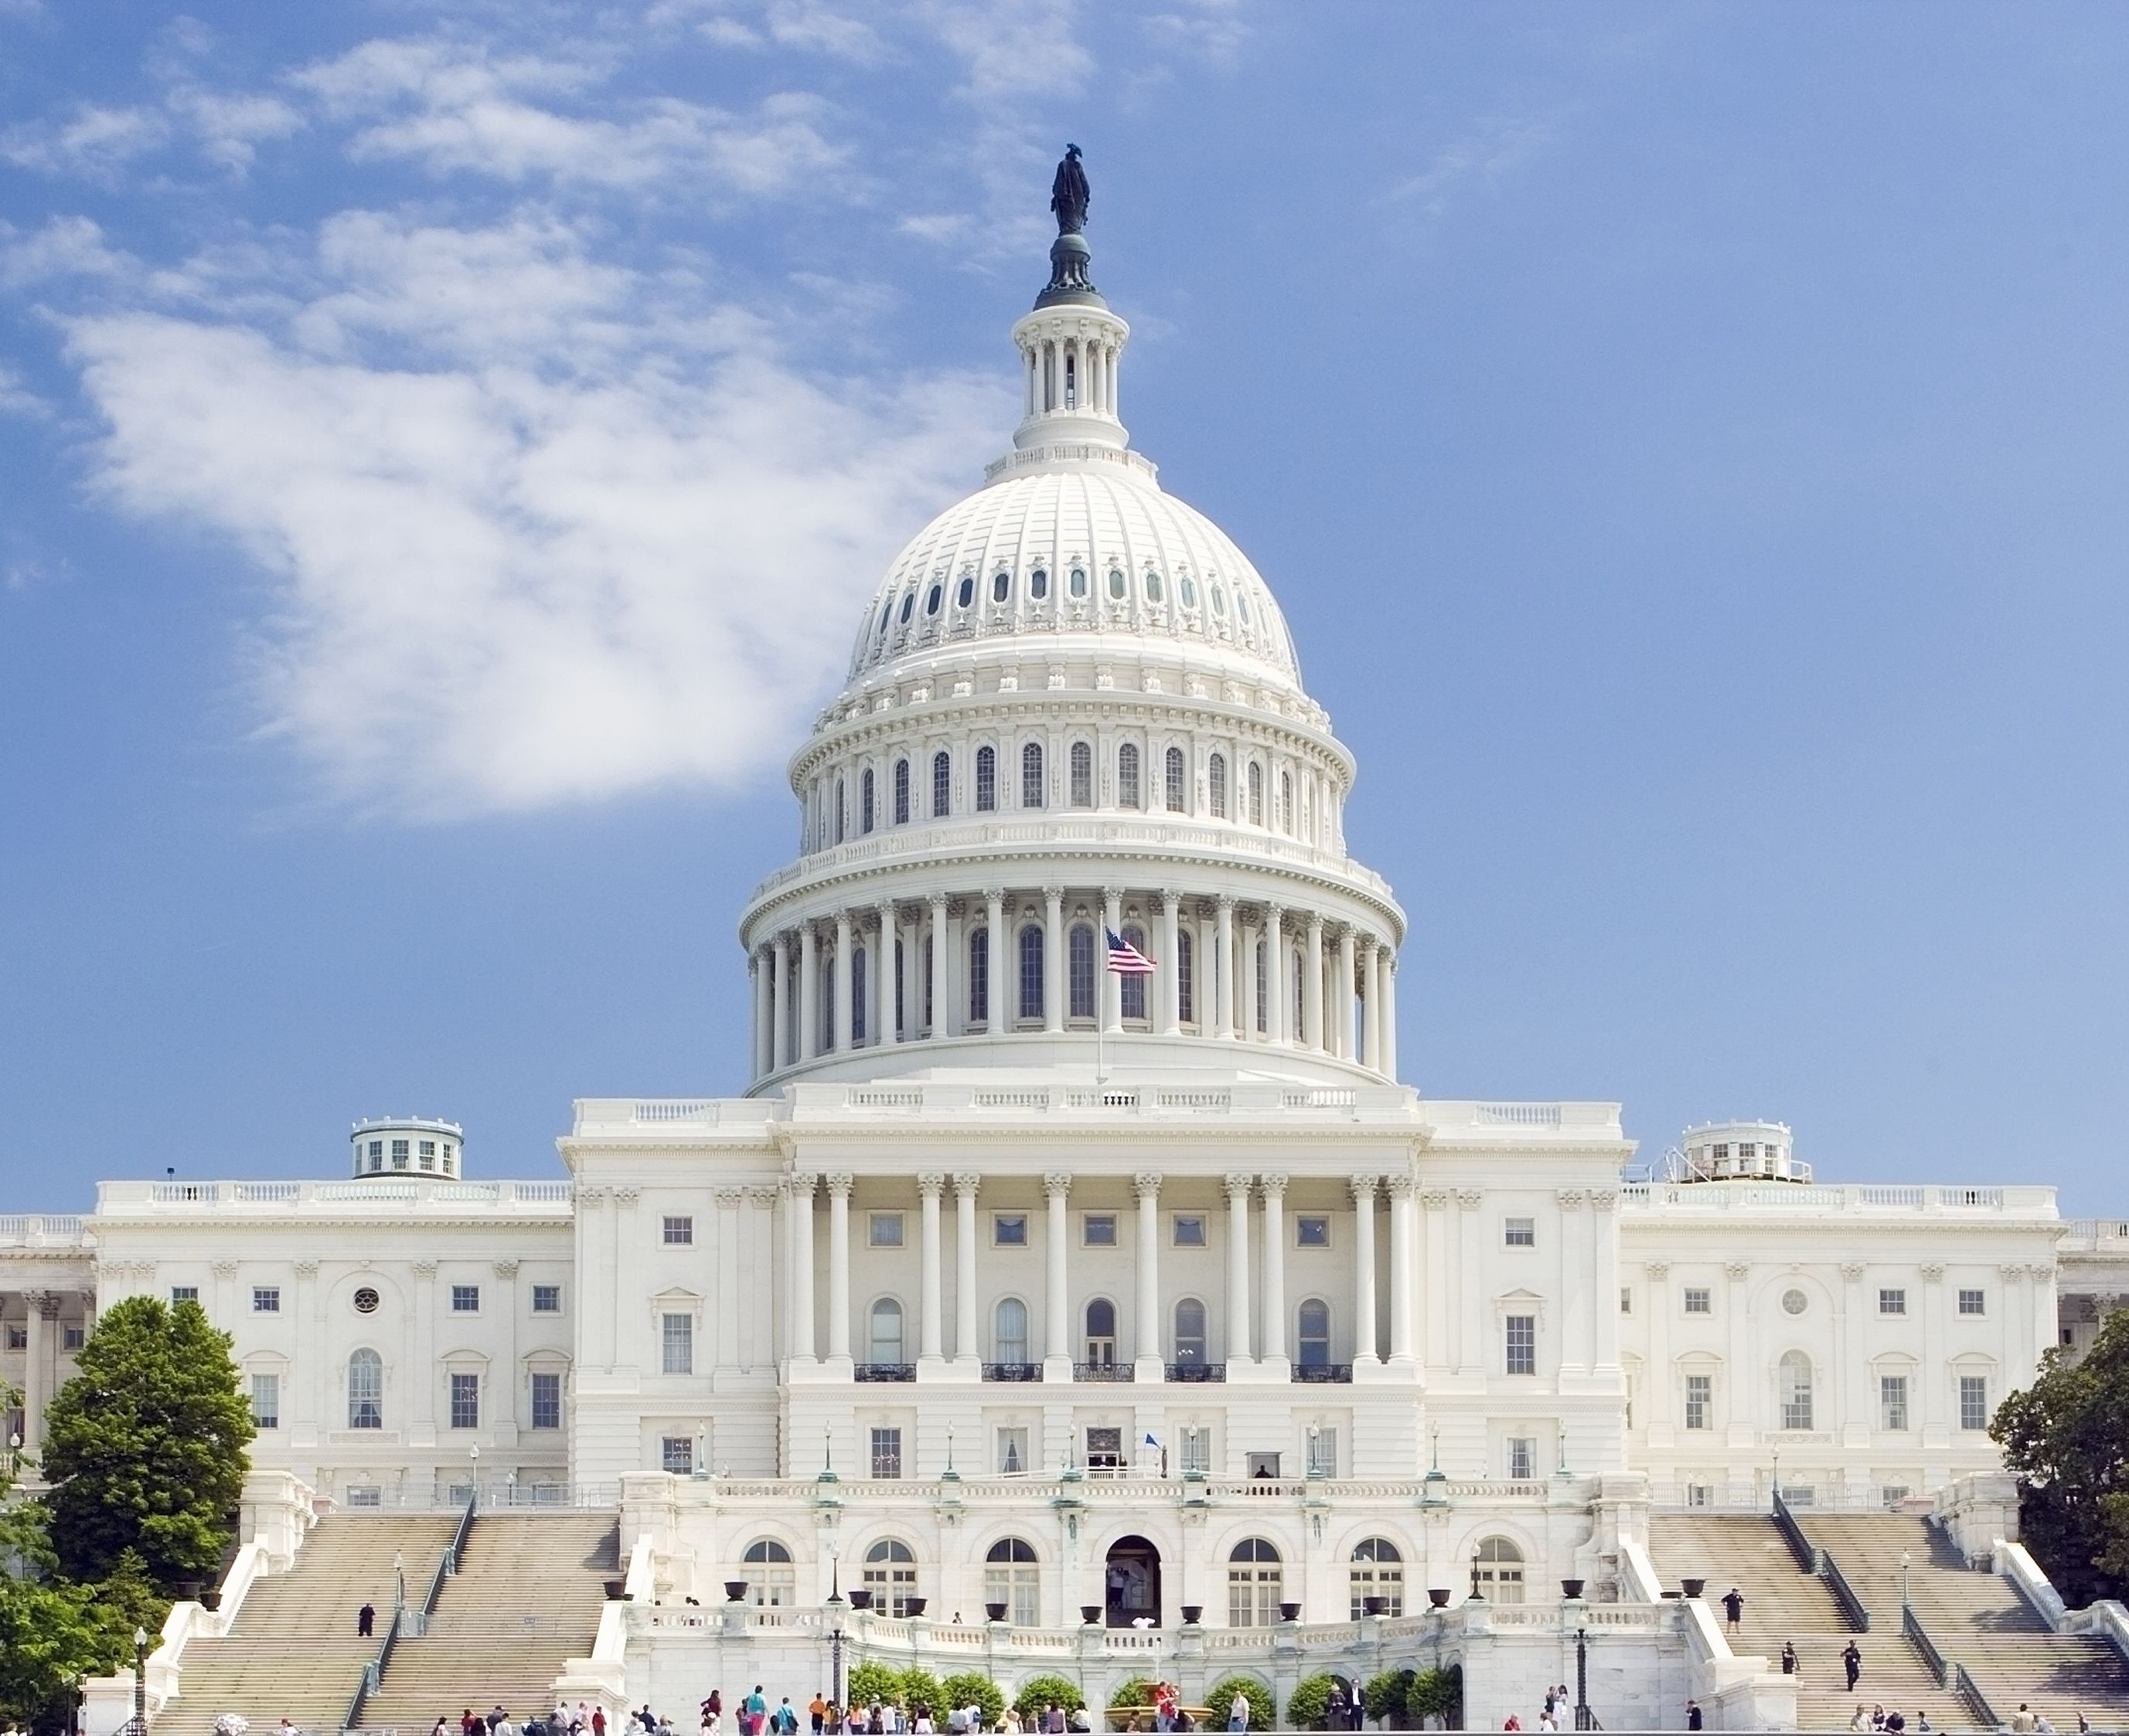
Increased Federal Funding is Available to SCDOT
$250 -300M Highway Formula Funds
+
Estimated $50-100M in
Redistributed funds from other states
42% Federal Funding
58% State Funding
$100M in recurring matching funds are needed to draw down these funds.

Slide 10
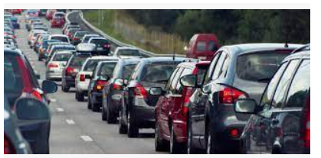
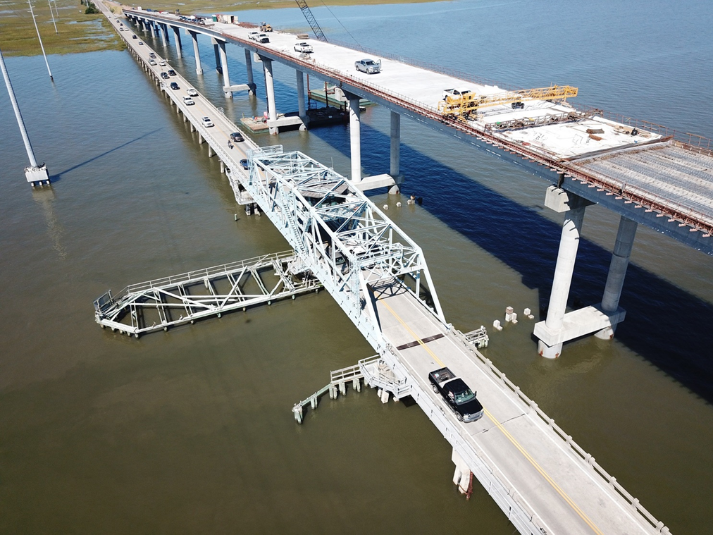
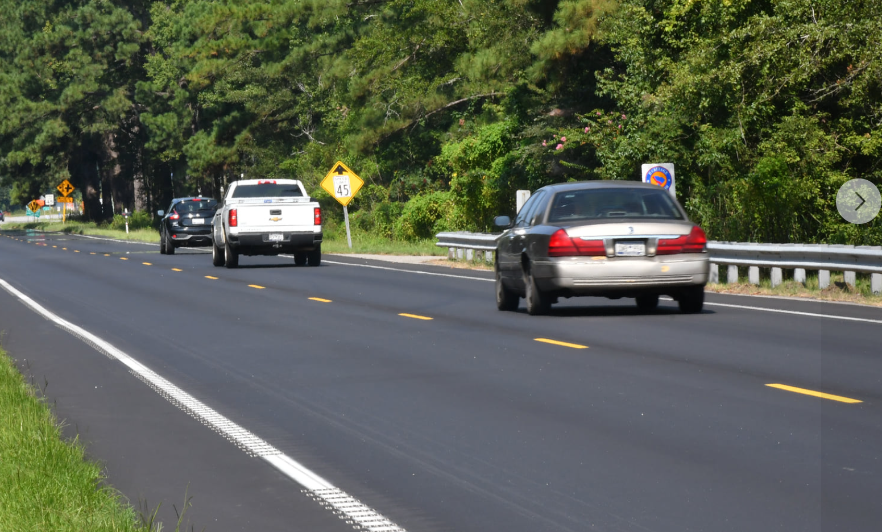
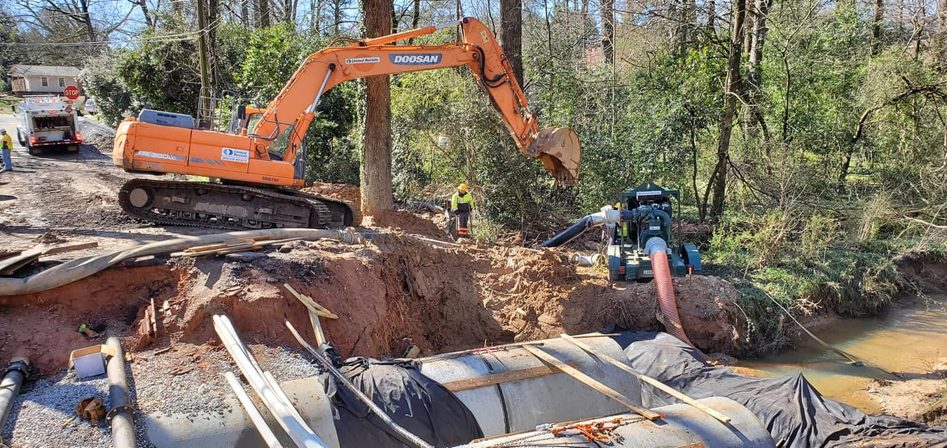
Revisions to the 10-Year Plan
More Paving & Safety Projects
Drainage
Projects
More Bridge Projects
More Interstate Work
Rural Economic Development Projects
Urban Projects to Combat Congestion & Delay

Slide 11
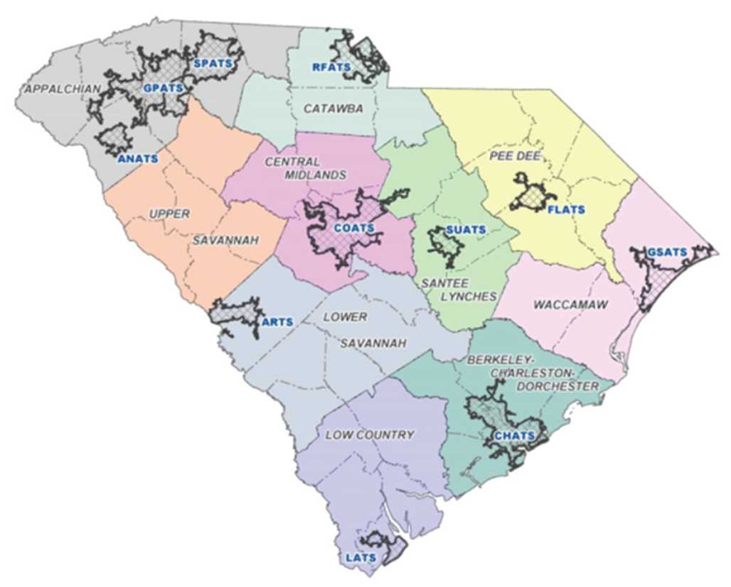
Regional Mobility
Addressing urban congestion and rural economic development was not addressed in last state funding bills.
Will increase annual funding from $138M to $238M over next four years.
Funding increased by $26M this year to give every MPO/COG a minimum of $4M.

Slide 12

Transformative Opportunities

Slide 13
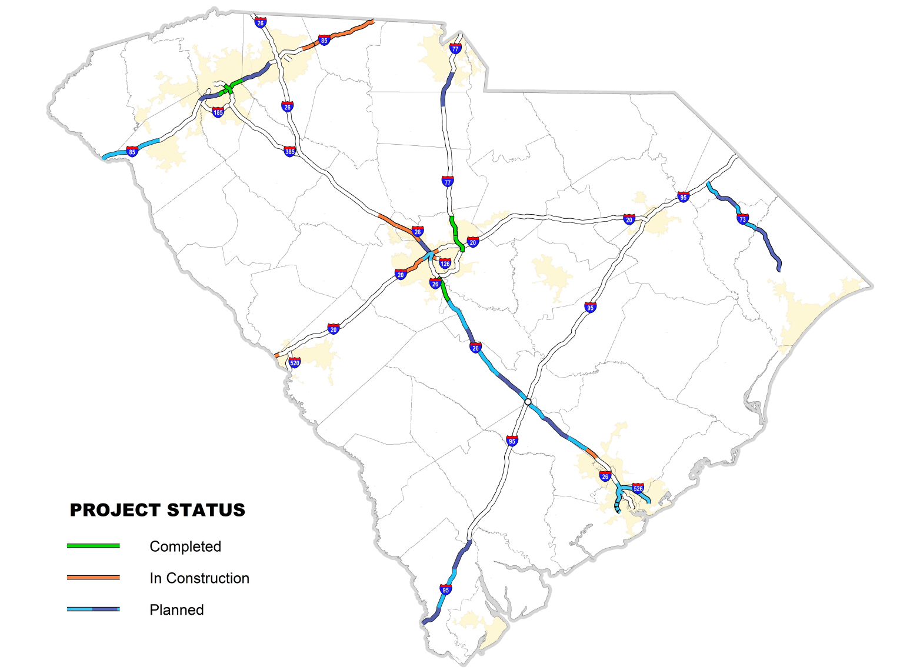
Current Interstate Widening Program
Includes New Federal Funding
$830M
TBD
$375M
TBD
≈2035
2023
Proposed Phase 1 @ $300M, subject to General Assembly appropriation
≈2035
CCR Phases 1&2
@ $285M
$97M
$522M
42% Federal Funding
CCR Phases 3-5 thru 2027
$126M
$75M
2024
2025
$50M
2035
2029
2026
2022
Preliminary Activities Underway on I 526 East & West
2023 Start Construction on Phase 1
(Airport & Wando Terminal Interchanges)
Remaining Phases Sequenced in 2027 and beyond
$70M
2031
2028
2023/24
Mark Clark Extension
County & SIB funded @ $725M
2024

Slide 14
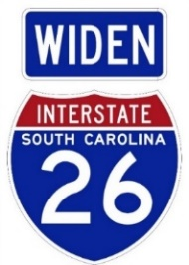
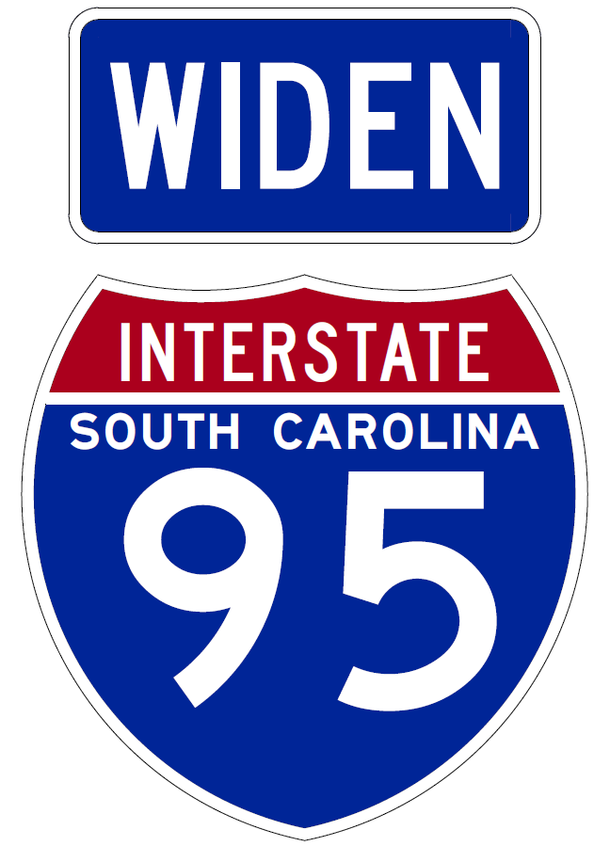
Acceleration Opportunities
$360M one-time infusion could accelerate by
6 years
42% Federal Funding
$200M one-time infusion could accelerate by
2-3 years
2023
Currently planned at ≈$1.5B over
next
13 years
2025
2029
2023
2026
2022
$453M in ARPA Funds and pending $133M in State Budget provide opportunity to accelerate these projects.
Currently planned at ≈$935M over
next 9 years
2028
2026
2024
Page 14

Slide 15
Office of Local Government Services: Open for Business
SOT
DS/F&A
Director of Local Gov’t
CTC
LPA
FPA/Grants
TAP
Contract Assurance

Slide 16

What’s Next with Office of Local Government Services?
Reviews and policy revisions are currently underway for LPA and TAP programs.
Preparing for the influx of discretionary grant opportunities.

Slide 17

Discretionary Grants
IIJA has created ~$100B in discretionary grants which presents an opportunity to bolster investments being made in new formula funds.
The Administration has signaled it intends to support both state and local projects with particular emphasis on projects that support rehabilitation, safety, multiple modes, equity, and environmental goals.
Requires SCDOT to adapt how it has historically reacted to discretionary grants.

Slide 18
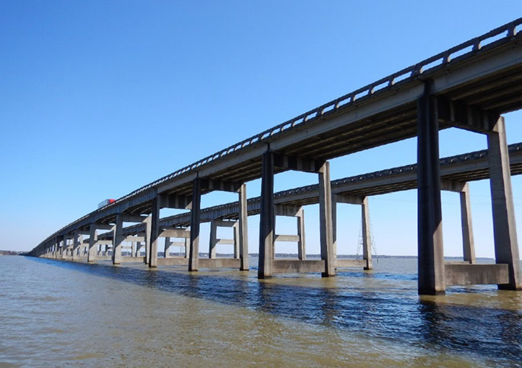
How Will SCDOT Pursue Grants?
Developing strategy for state pursuit and local coordination.
Focus on projects that align with 10-Year Plan:
  Pavements
  Rural Road Safety
  Interstates
  Bridges
Will not pursue grants not aligned with priorities.
SCDOT will focus on mega-bridges like I-95 over Lake Marion in its applications.

Slide 19
How Will SCDOT Work with Locals Seeking Grants?
97% of the federal-aid eligible roads in South Carolina are state highways with an integrated planning process with MPO’s and COG’s which serves to incorporate local feedback.
SCDOT is focusing its resources on the delivery of the 10-Year Plan.
If a local government pursues a grant for a project on the State Highway System, it needs to notice the Office of Local Government Services in advance of the grant application.
  SCDOT will issue a letter regarding project impacts to the State Highway System.
Local governments should be prepared to manage all aspects of the project including grant application development, securing match funding, design, and construction.
  SCDOT establishing on-call contract to assist locals with grant responsibilities.

Slide 20
For More Information
Justin Powell
Deputy Secretary
for Finance and Administration
powelljp@scdot.org
803-737-1240 (office)
Roxanne Ancheta
Director of Local Government Services
anchetarm@scdot.org
803-737-1232 (office)

