Slide 1
SCDOT Update
South Carolina City/County Management Association
January 20, 2023

Slide 2
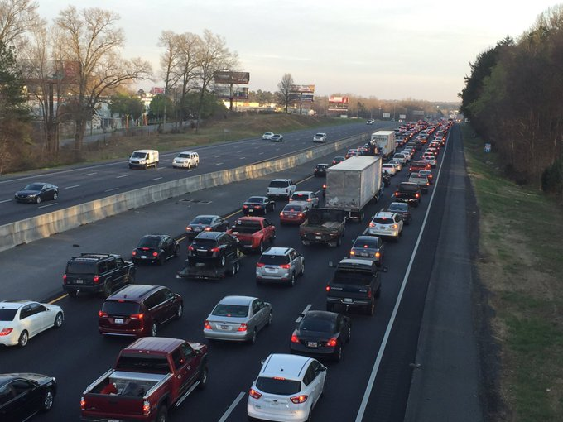
4th largest state highway system in the United States
serving the
5th fastest growing state
based on last year’s population data

Slide 3
The 2017 launching of a Strategic 10-Year Plan to repair and make upgrades to the existing
transportation network was enabled by bold action of the General Assembly to double state funding for roads in South Carolina.
Rural Road Safety
Paving
Bridges
Interstates

Slide 4
SCDOT has Dramatically Increased its Work Program
≈$4.4B
$1B

Slide 5
10-Year Plan Accomplishments
Rural Road Safety
Paving
Bridges
Interstates
855 miles
New Target of 1,250 miles
>6900 miles
Pavements Measuring Good Have Doubled
287 bridges
New Target of 500 Bridges
101 miles
215 Miles Targeted

Slide 6
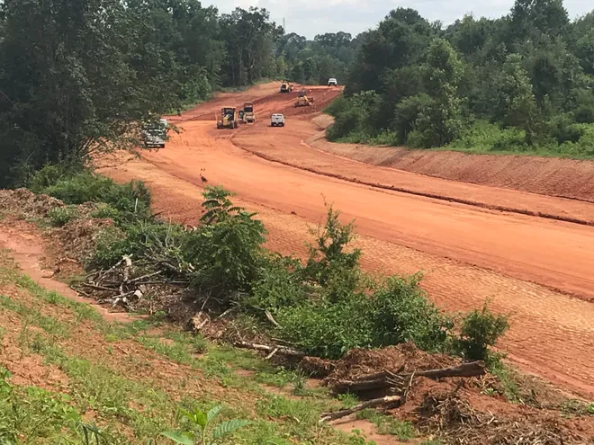
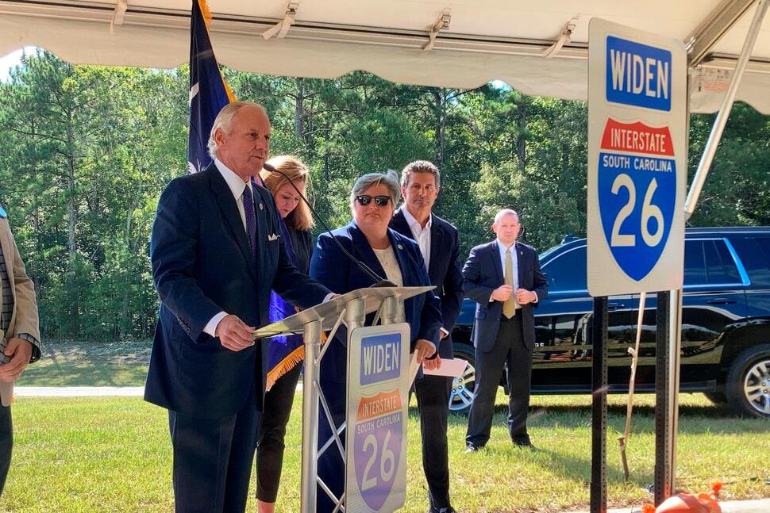
Thanks to the recent actions at the federal and state levels, SCDOT can incorporate projects into our Strategic 10-Year Plan to deal with the growth and economic development needs of our state.

Slide 7
Action at the Federal Level
New federal aid program has increased SCDOT’s annual federal funding by approximately $250-300M, requiring additional state match to fully draw all possible dollars.
42% Federal Funding
58% State Funding
SCDOT directed the majority of these new federal funds to Regional Mobility Programs (MPO/COG) and Bridges

Slide 8
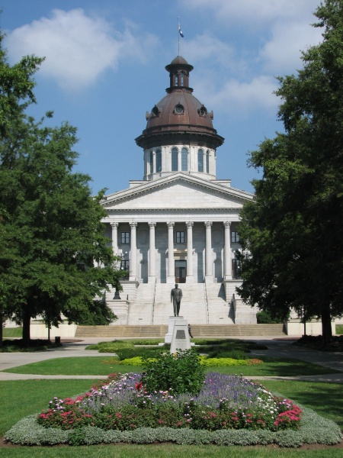
General Assembly Actions - 2022
Provided $120M in match funds to fully draw down federal formula funds, as well as other states’ unused funds, and to pursue competitive grants.
Allocated $453M in ARPA Funds and $133.6M in General Funds towards SCDOT’s rural interstate capacity program.
Appropriated $250M toward County Transportation Committees for locally-driven state and local road projects.
Yielded $190 Million More Federal $
42% Federal Funding
58% State Funding
Accelerated the Widening of I-26 by 6 Years and I-95 by 3 Years
Added More Paving Projects Statewide

Slide 9
Opportunities for Local Governments

Slide 10
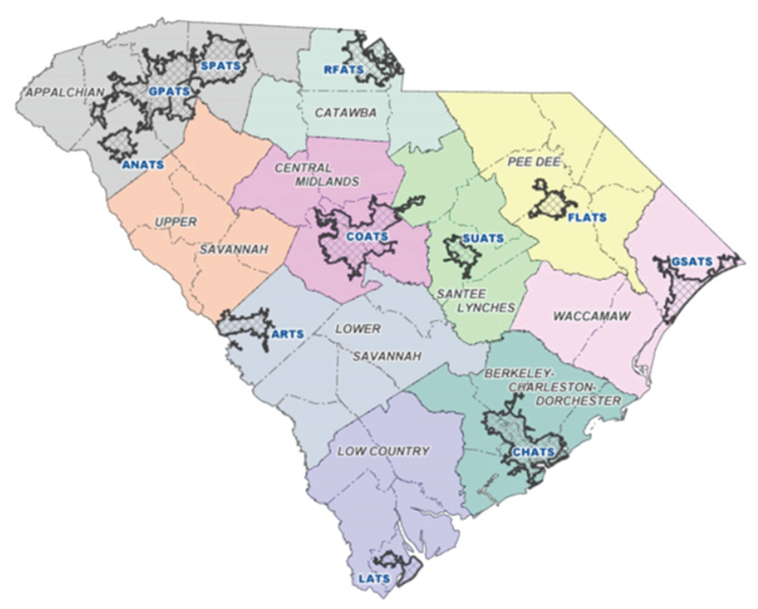
Regional Mobility
Ramping up funding by $100M over the next four years.
Strongly encourage local governments to work with their MPO in urban areas or COG in rural areas for locally-desired projects.
Projects integrated into long-range regional plans stand better chances for competitive grants and SIB applications.

Slide 11
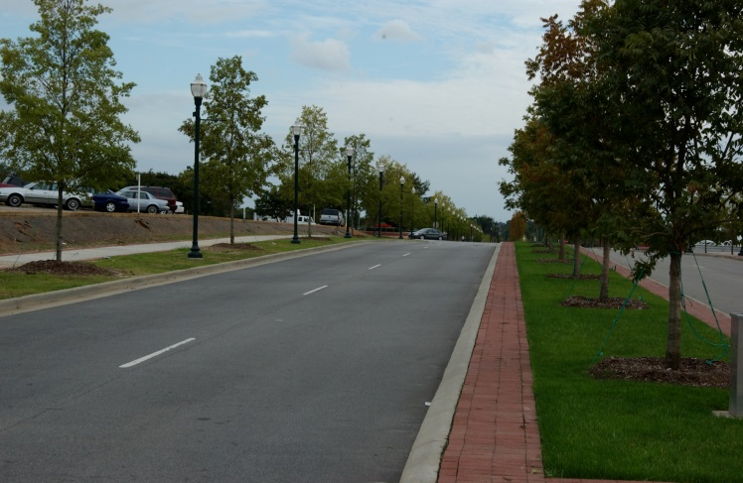
*NEW* Transportation Alternatives Program (TAP)
IIJA Requirements
New population categories
Prioritization of project location and impact in high-need areas as defined by the State
SCDOT Priorities
Increased emphasis on safety
Prioritization of projects that align with SCDOT’s Complete Streets Policy and TA-eligible projects in SCDOT’s 10-Year Plan, TIPs, STIP, LRTPs, and other planning documents
Call for applications twice a year in April and October
Project phase awards to assist in preventing lapse
No Max Award Amount / Minimum total project cost $500k
https://www.scdot.org/projects/community-transportation-alternatives.aspx
Notes:
SCDOT has revised its TAP program! We basically did a complete overhaul to include IIJA requirements as well as to better reflect SCDOT’s priorities.
IIJA further defined the population categories that SCDOT oversees.
FHWA provides TAP funds to SC through two avenues:
Transportation Management Areas (TMAs) for urbanized areas over 200K (ARTS, CHATS, COATS, GPATS, GSATS, RFATS; these entities make their own rules / award their own TAP projects; any entities within these areas must apply for TAP funds via the TMA)
SCDOT manages the TAP program for areas under 200K. IIJA broke down population categories as follows:
Small Urban: 50,000 – 200,000
Small Urban: 5,000 – 49,999
Rural: Less than 5,000
IIJA required prioritization of project location / impact in high-need areas: We have defined “high need” in accordance and alignment with SCDOR’s annual county tier rankings (Tiers 1-4, with counties in tiers 3 and 4 being our more economically disadvantaged counties). Up to 100% local match may be provided for projects in Tiers 3 and 4, as well as tiers 1 and 2, depending on project location.
We also incorporated and further emphasized our agency’s priorities, including safety as our TOP priority, which is reflected in the application scoring matrix.
We are also encouraging alignment with our Complete Streets policy, as well as emphasizing projects that are included in planning documents like Long Range Transportation Plans, Bike/Ped Plans, etc., which shows some level of thought and planning and intention has gone into a project, and it’s not being pulled from the air.
There will be two calls for Letters of Intent (leading to applications if the projects are viable) each April and October. The call for the first round of FFY23-24 TAP funds will be around the beginning of April…stay tuned!
We are doing more up-front project scope / budget review on the front end to help ensure successful projects and to prevent lapse. We are coordinating with COGs to assist in the review of TAP applications. We welcome the local feedback and look forward to this new partnership – it’s a win-win for both parties!
Internal evaluation team comprised of multi-disciplinary folks (RPGs, Planning, Safety, etc.) will make recommendations for award.
We may phase TAP awards. For instance, someone might come in with a $10M project; we can phase that in terms of phase of work: preliminary engineering / right of way acquisition / construction and provide funds according to phase. This will help prevent lapse instead of awarding $10M all at once and starting the clock.
We got rid of the $400k max award cap; a project costs what it costs. There is a minimum total project cost: $500k. We want to fund good, impactful projects, so these award guardrails reflect that.
We have a ton of resources for the new program at the web address on the slide, including a recording of our TAP workshop, the revised TAP program guidance document, and more.

Slide 12
Competitive Grants
Infrastructure Investment and Jobs Act has $100B in competitive grants available to state and local governments.
If a local government pursues a grant for a project on or connecting to the State Highway System, it needs to notice the Office of Local Government Services well in advance of the grant application.
Locals should be prepared to independently seek and manage the awarded grant.
Notes:
Agreements have gone out to 10 qualified firms selected for the on-call list. Once these agreements have all been signed and are in place, we will publish the information online (SCDOT’s grants website – on an upcoming slide).
Local governments receiving grant awards may choose to work with these firms (must procure them according to their procurement ordinance / guidelines and pay for their services).

Slide 13
Questions?

